Slide 1
Healthy Eating Week 2022
13-17 June 2022

Slide 2

What’s it all about?
The British Nutrition Foundation’s Healthy Eating Week is taking place from 13-17 June 2022.
The Week highlights what you can do to have a healthier and more sustainable diet and lifestyle.
The big message for the Week is:
  Eat well for you and the planet!

Slide 3
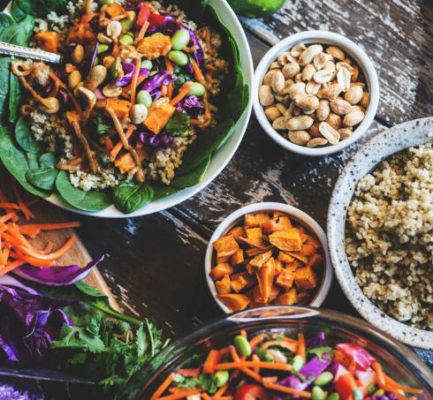
What is a healthier and more sustainable diet?
Healthier and more sustainable diets consider and balance:
  Health
  Nutrition
  Environment
  Affordability
There is no one-size-fits-all approach, however there are positive changes you can make.

Slide 4
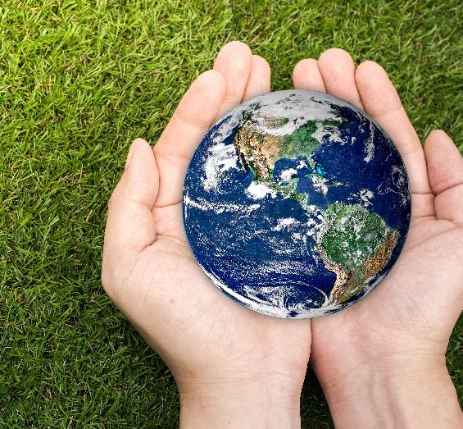
Why are healthier and more sustainable diets important?
The balance of foods that we eat is important for our health and the planet.
So much goes into producing our food and drinks - water, energy, land, and transport!
The global food system is responsible for:
  1/5 to 1/3 of all greenhouse gases
  Over 2/3 of global freshwater use
  Over 1/3 of global land area.

Slide 5



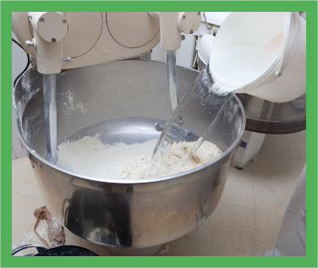
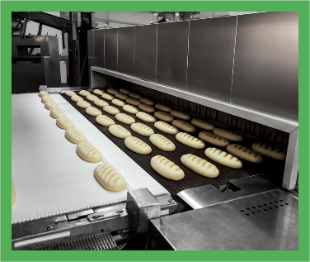
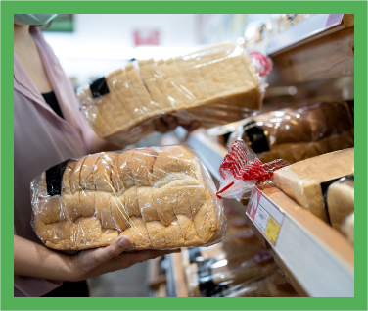
Example: What goes into producing bread?
Land
Fuel
Transport
Water
Oven (Energy)
Packaging

Slide 6
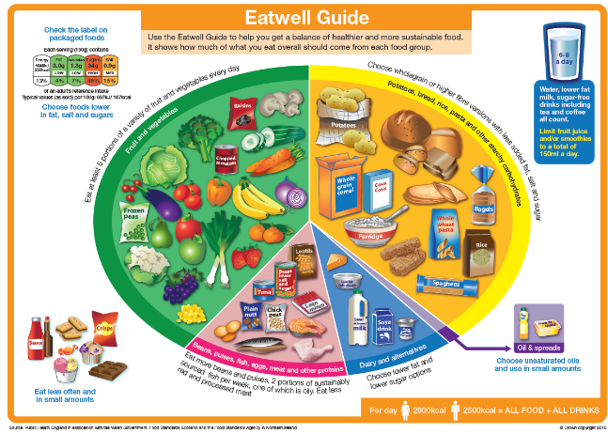



How can we eat a healthier and more sustainable diet?
The Eatwell Guide is the UK’s healthy eating model
This is a plant-rich style of eating that can also include some nutrient-rich animal-based foods (meat, milk, eggs, fish, and dairy)
Following the Eatwell Guide more closely can have environmental and health benefits:
30% lower greenhouse gases
4% lower water use
Reduce the number of new cases of type 2 diabetes, heart disease, and stroke in the UK population
Sources: Scheelbeek et al. (2020) BMJ Open 10:e037554; Cobiac et al. (2016) PLOS ONE 11: e0167859

Slide 7
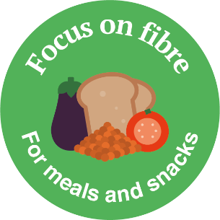
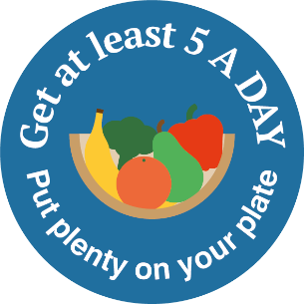



Themes of the Week
Each day of the Week focuses on a theme to help you to make positive changes.
Monday
Tuesday
Wednesday
Thursday
Friday
Focus on Fibre
Get at least 5 A DAY
Vary Your Protein
Stay Hydrated
Reduce Food Waste

Slide 8
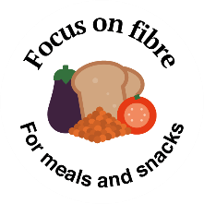
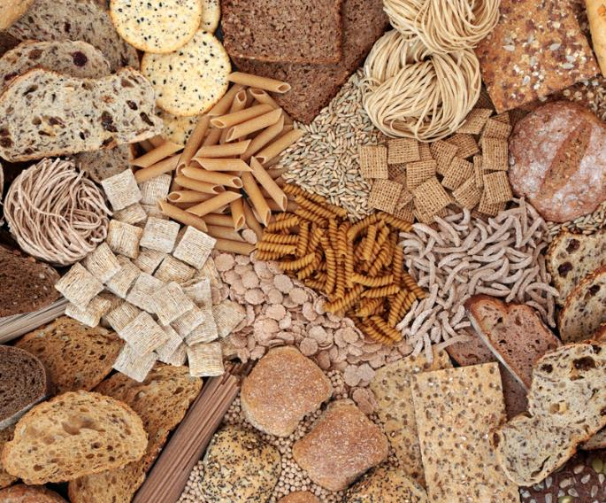
Focus on fibre – for meals and snacks
Have more wholegrain foods, fruit and vegetables, beans, peas and lentils.
Eating plenty of fibre is associated with a lower risk of heart disease, stroke, type 2 diabetes and bowel cancer.
A plant-rich diet* can help us to increase fibre intake and also helps reduce the environmental impact of what we eat.
* A plant-rich diet can also include animal based foods such as some meat, dairy, fish and eggs.

Slide 9
What wholegrain foods do you eat?

Slide 10
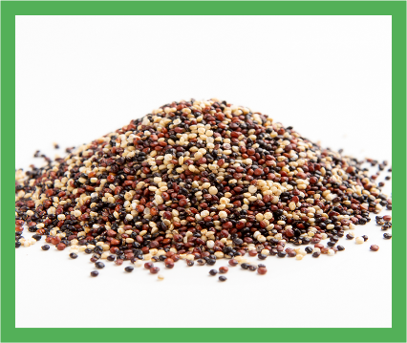
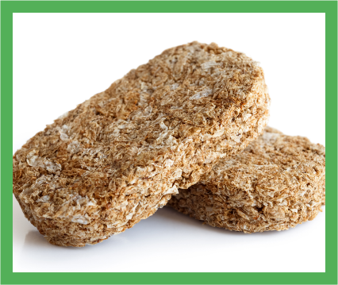
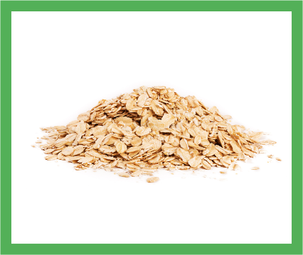
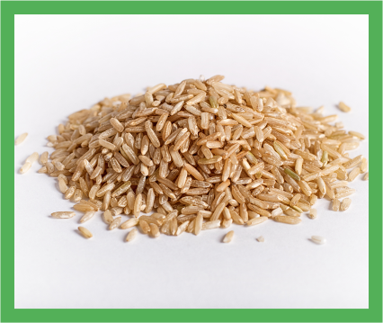

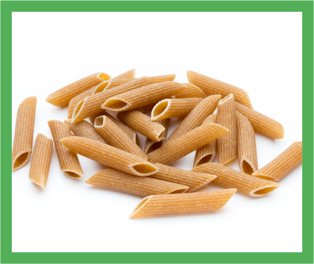
Here are some examples of wholegrain foods
Notes:
Answers
Image 1: Quinoa
Image 2: Wholewheat biscuits
Image 3: Oats
Image 4: Brown rice
Image 5: Wholemeal pitta or chapati
Image 6: Wholewheat pasta

Slide 11
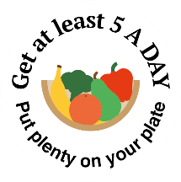
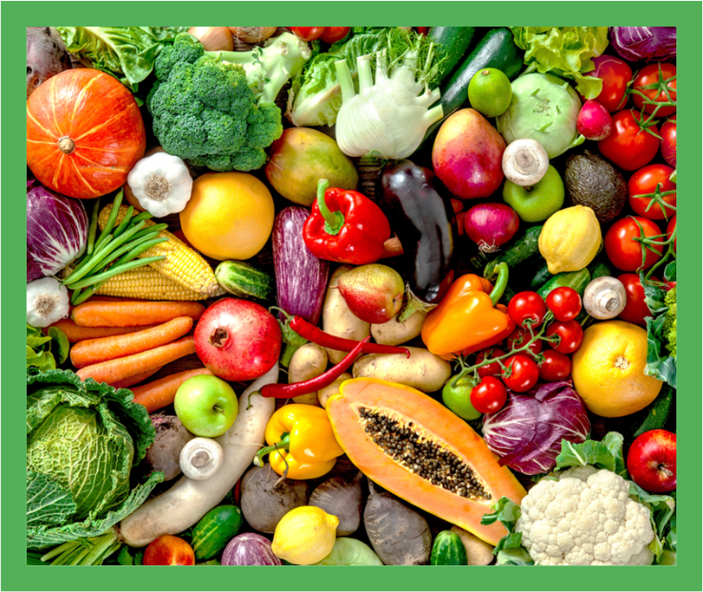
Get at least 5 A DAY - put plenty on your plate
Have at least 5 portions of a variety of fruit and vegetables every day.
Fruit and vegetables provide us with vitamins, minerals and fibre.
Fruit and vegetables tend to have a low environmental impact.

Slide 12
How many portions of fruit and vegetables
do you eat each day?

Slide 13
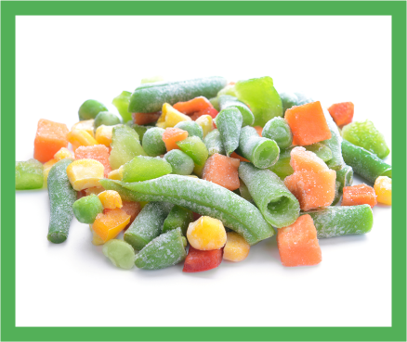
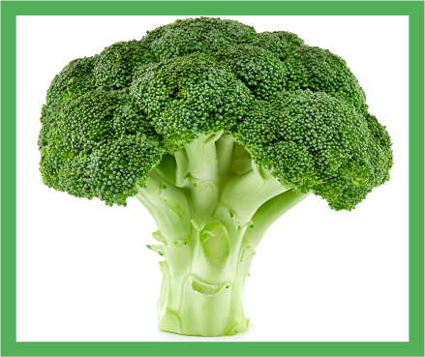
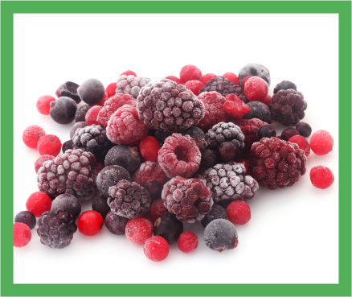
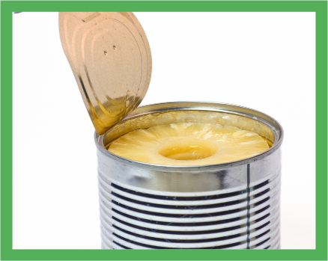
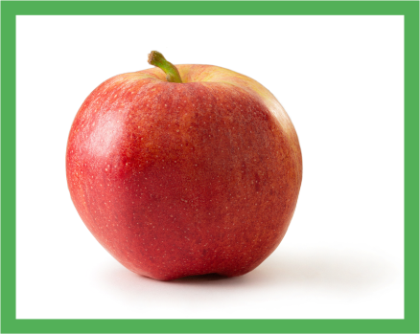

Here are some examples of fruit and veg
Notes:
Answers
Image 1: Frozen mixed vegetables
Image 2: Broccoli
Image 3: Frozen mixed berries
Image 4: Canned pineapple in natural juice with no added sugar or syrup
Image 5: Apple
Image 6: Cauliflower

Slide 14

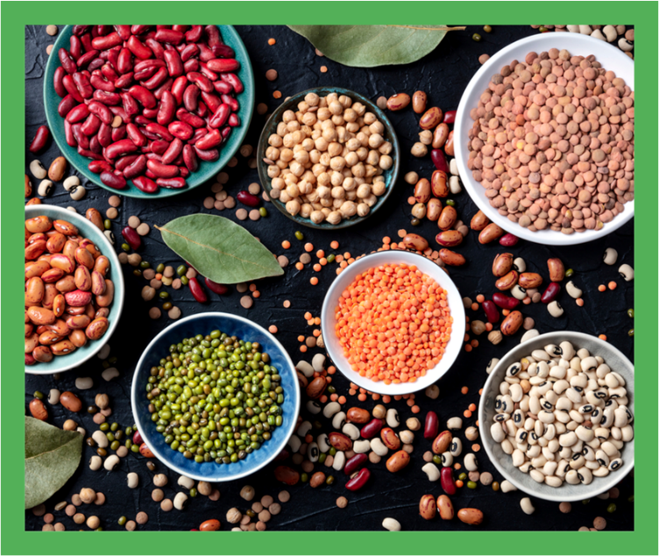
Vary your protein - be more creative
Eat a wider variety of protein foods and choose plant-based protein more often.
Plant-based proteins can include pulses (peas, beans, lentils), nuts and seeds.
Plant-based proteins can provide fibre, vitamins and minerals.
Growing pulses can help the planet by improving soil health and reducing the need for fertilisers.

Slide 15
Have you ever tried pulses like beans or lentils?

Slide 16
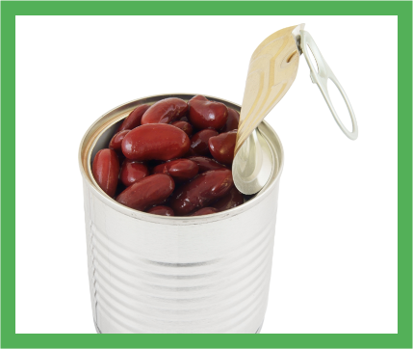

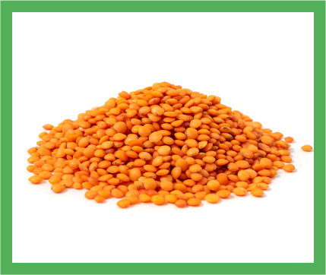
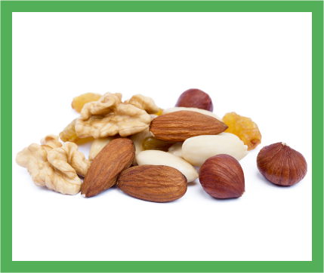
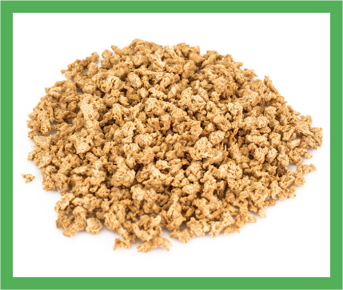
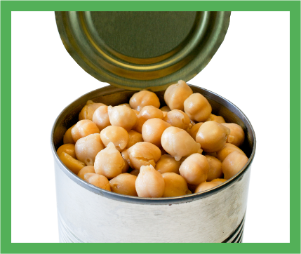
Here are some examples of plant protein
Notes:
Answers
Image 1: Canned red kidney beans in water with no added salt
Image 2: 100% peanut butter
Image 3: Red lentils
Image 4: Unsalted mixed nuts
Image 5: Vegetarian mince
Image 6: Canned chickpeas in water with no added salt

Slide 17



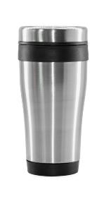
Stay hydrated - fill up from the tap
Have about 6-8 drinks a day (about 1.2 litres) and choose reusable or recyclable drinks containers.
Drinking plenty can stop us from becoming dehydrated, especially if we are more active and during hot weather.
Reusable drinks containers can reduce single-use packaging.

Slide 18
Do you have 6-8 drinks each day?

Slide 19


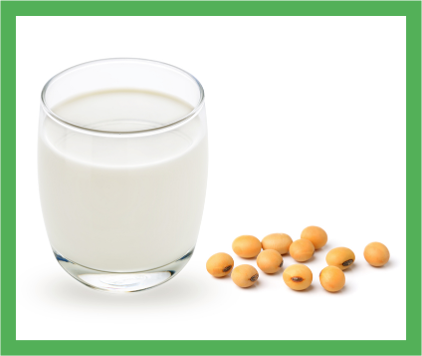




Here are some examples of drinks
Remember to choose unsweetened milk alternatives, such as soya drinks, that are fortified with calcium and preferably other vitamins and minerals.
Notes:
Answers
Image 1: Tap water (infused with cucumber and mint)
Image 2: Tea
Image 3: Unsweetened and calcium-fortified soya drink
Image 4: Lower fat milk
Image 5: Orange juice (150ml)
Image 6: Mint tea

Slide 20

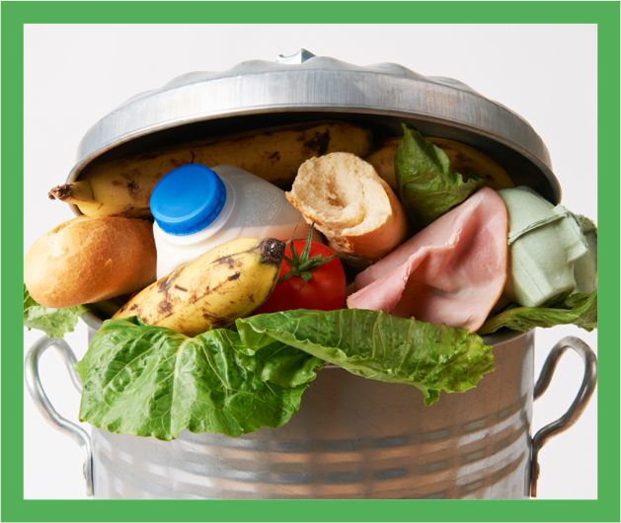
Reduce food waste - know your portions
Aim for the right amount when you shop, cook and eat to avoid throwing food away.
Reducing food waste is good for our pocket and the planet:
  Food waste costs the average UK household (with children) £60 per month.
  Food waste contributes to 8-10% of greenhouse gas emissions.

Slide 21
Do you and your family use up leftovers?

Slide 22
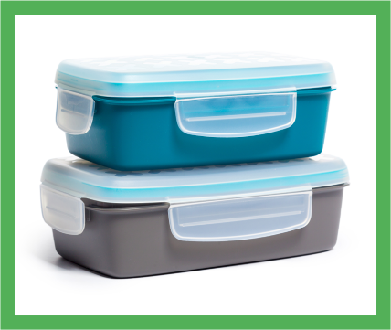
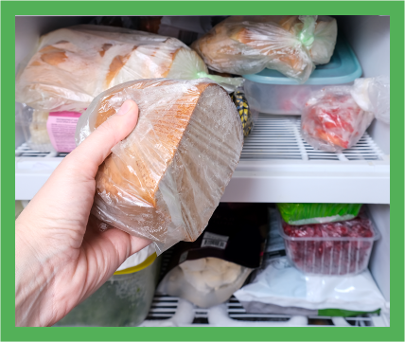



Here are some ways to reduce food waste
Notes:
Answers
Image 1: Choose frozen
Image 2: Store food in air-tight containers
Image 3: Freeze leftovers
Image 4: Set your fridge temperature to 0-5℃​
Image 5: Plan your meals - create a shopping list
Image 6: Know your “best before” and “use by” dates

Slide 23
We hope you enjoy Healthy Eating Week 2022!
For more information, go to: https://www.nutrition.org.uk/healthy-eating-week/

