Slide 1
National Schools Breakfast Week
9 -13 September 2024

Slide 2
Why do we eat breakfast?
Breakfast provides us with a source of energy to start the day.
Eating breakfast regularly may help us to be more alert and able to concentrate in lessons.
Eating a healthy breakfast can contribute important vitamins and minerals, like B vitamins and iron (in cereals), vitamin C (in fruit) and vitamin D (in eggs and fortified yogurts).
Breakfast can also provide us with other nutrients, such as protein and fibre.

Slide 3
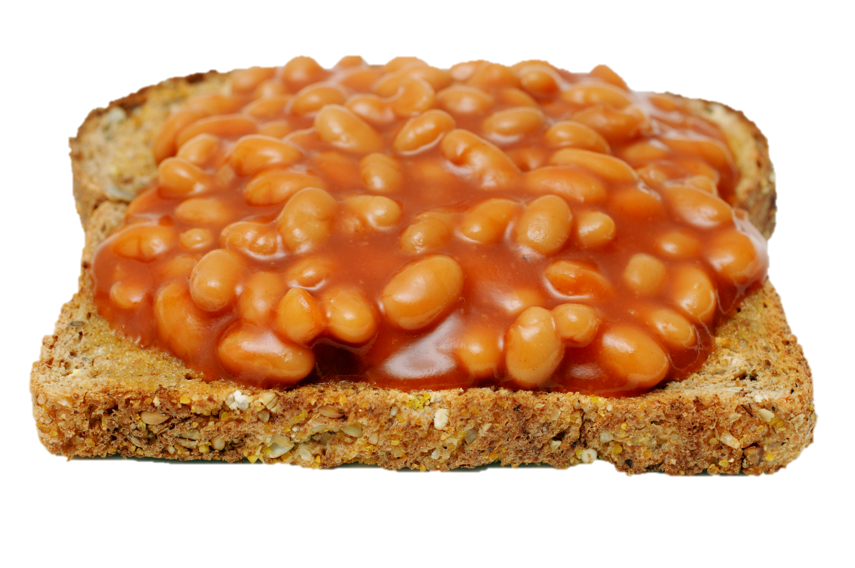
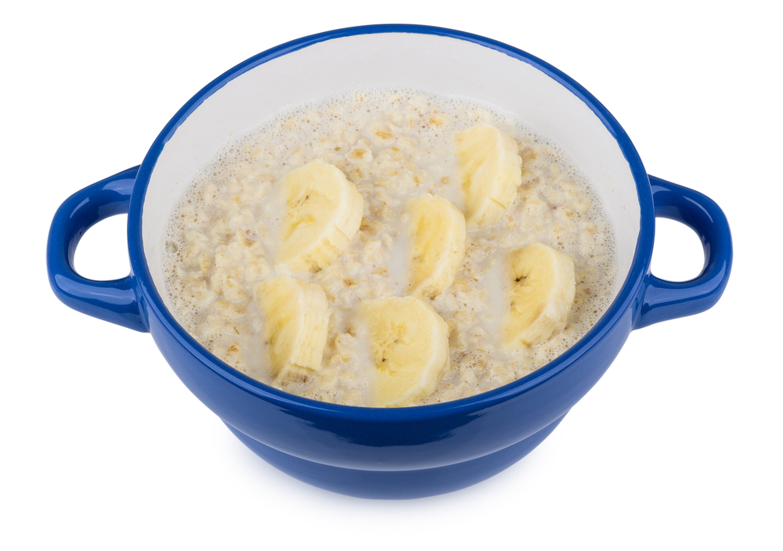
What’s in a healthy breakfast?
A drink
Water
Milk
Starchy wholegrain
Wholemeal bread
Wholegrain breakfast cereals
Oats
Fruit and/or vegetables
Banana
Berries
Tomatoes
Protein and/or dairy foods
Beans
Eggs
Yogurt

Slide 4
Drinks at breakfast
Water is always a good choice!
Milk can hydrate and provide some protein and other nutrients (e.g. calcium).
Remember, we should have about 6-8 drinks each day.

Slide 5
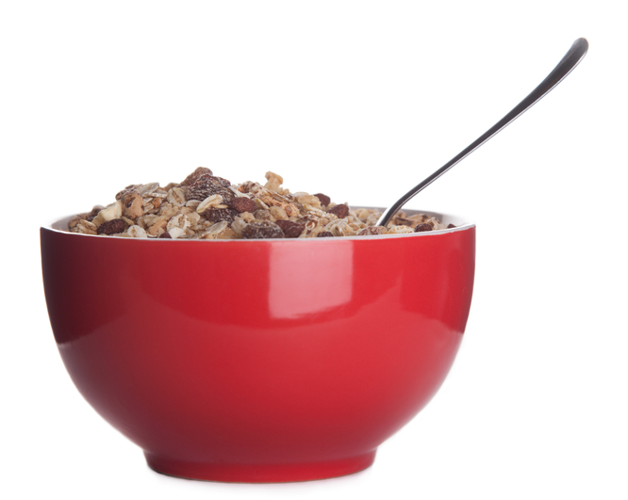
Starchy wholegrains
Starchy wholegrains are a good source of fibre.
Fibre is important for our digestive health.
In the long-term, high fibre diets may also reduce the risk of certain diseases, such as colorectal cancer, heart disease and type 2 diabetes.
Many of these foods (cereals and bread) are fortified with additional nutrients, such as iron, vitamin D and B vitamins.

Slide 6
Fruit and vegetables
Fruit and vegetables can provide nutrients such as vitamin C.
They also provide additional fibre.
Fruit can be added to cereal or yogurt.
Vegetables like spinach and mushrooms can be added to a cooked breakfast (e.g. omelette).
Salad vegetables like cucumber and tomato can be great on wholemeal toast!

Slide 7
Protein and dairy
Protein is important for muscle and bone growth and development.
Foods like beans, eggs, yogurt, cheese and milk can contribute.
Dairy foods also provide calcium, which is important for healthy bones and teeth.
Dairy alternatives are usually fortified with calcium too, but check the label!

Slide 8
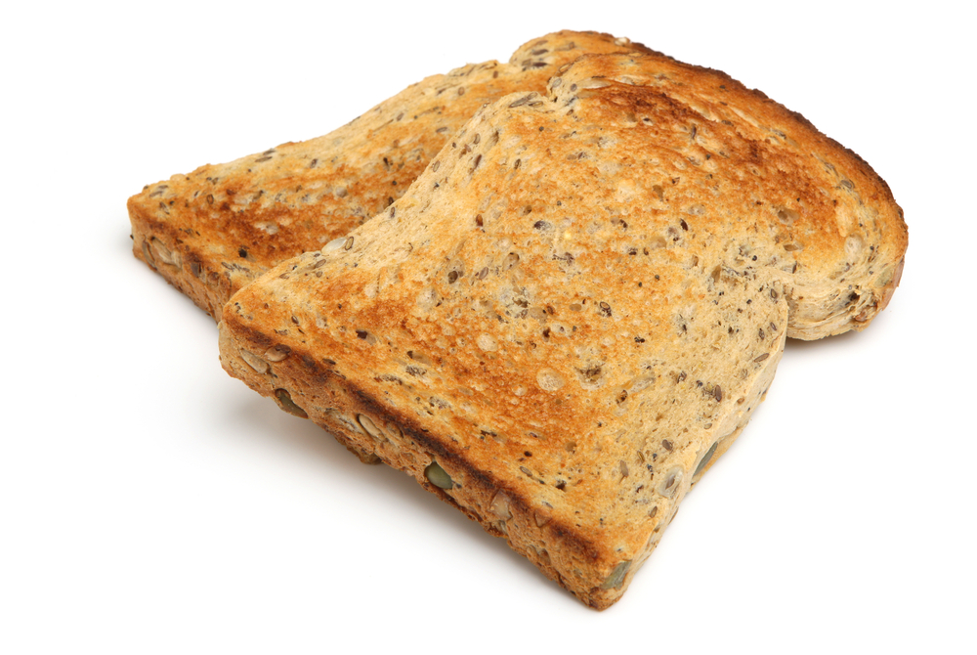
Breakfast on the go!
Plan and make breakfast in advance
Make your breakfast the night before and take it with you! You could try…
- baked oats
- overnight oats
- a cheese and tomato sandwich
Grab some fruit to eat on the go:
- banana
- orange
Take your toast with you!

Slide 9
Nutrients at breakfast time
Carbohydrate
Provides energy
Starchy foods
Protein
Needed for healthy muscles and bones
Beans, eggs, yogurt, cheese
Fibre
Important for a healthy gut
Cereals, bread, fruit, vegetables, beans
B vitamins
Helps to release energy from food
Fortified cereals, milk, yogurt
Vitamin C
Supports the immune system and skin
Fruit and some vegetables
Calcium
Supports healthy bones
Milk, cheese, yogurt, fortified alternatives
Iodine
Supports brain health and growth
Milk, cheese, yogurt, eggs
Iron
Supports brain and blood health
Fortified cereals, bread, dried fruit
Zinc
Supports the brain, skin and immune system
Wholegrain cereals, wholemeal bread

