Slide 1
Healthy Eating Week -For Everyone!
Primary school introduction
Dear Teachers,
You can use this presentation for an assembly, or in class, to introduce Healthy Eating Week to your pupils.
A webinar recording, based on this presentation, will also be available at the end of May, here.

Slide 2
It’s Healthy Eating Week 2023!
This year’s Healthy Eating Week has five themes to help everyone eat well!
Let’s find out more!
Look out for the helpful food characters in this presentation. How many can you spot?

Slide 3
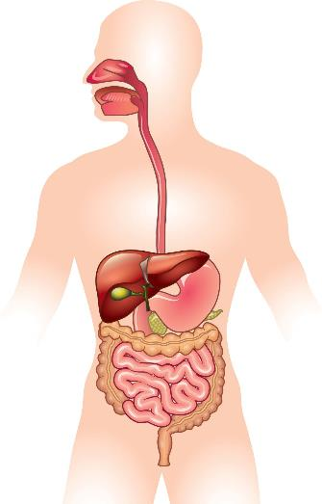
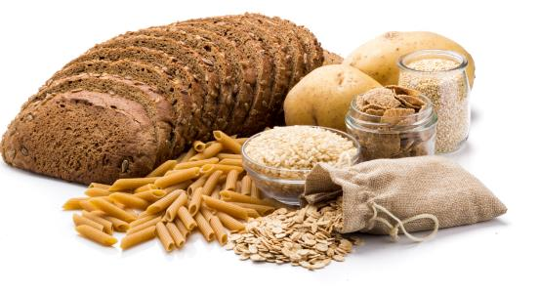
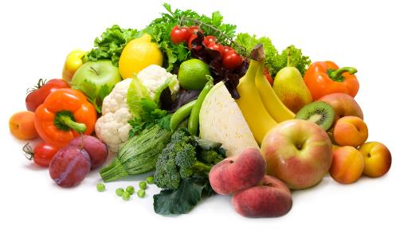
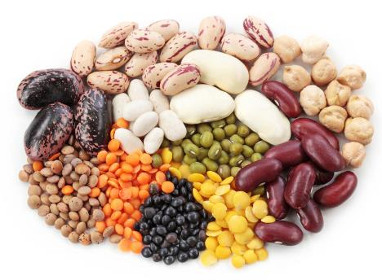
Focus on fibre – for meals and snacks
Why do we need fibre?
Where does fibre come from?
Wholegrain foods
Fruit and vegetables
To keep our digestive system healthy.
Beans, peas and lentils

Slide 4
Focus on fibre – for meals and snacks
Name the foods you can see here.
Fruit and vegetables
Wholegrain foods
Beans, peas and lentils

Slide 5
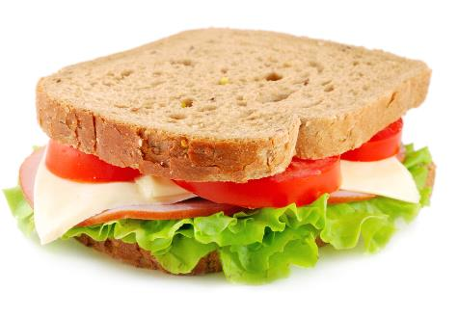
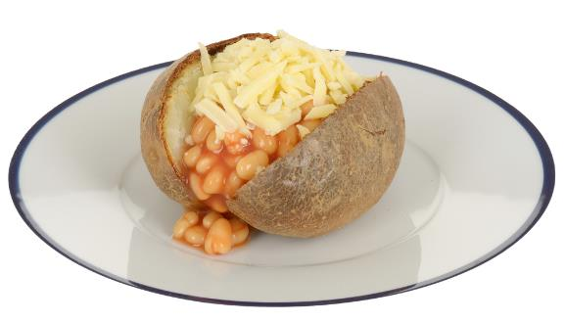
Find the fibre!
Where is the fibre in these dishes?
Foods that provide fibre
Wholemeal bread
Wholegrain foods
Tomato and lettuce
Fruit and vegetables
Potato with skin on
Beans
Beans, peas and lentils

Slide 6
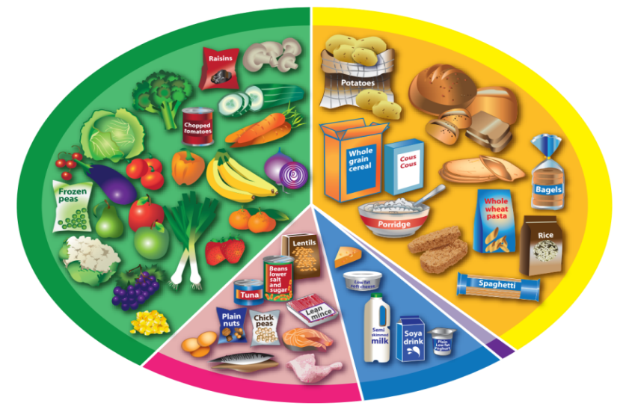
The Eatwell Guide
Foods that provide fibre
Where are the foods that provide fibre on the Eatwell Guide?
Wholegrain foods
Fruit and vegetables
Beans, peas and lentils

Slide 7
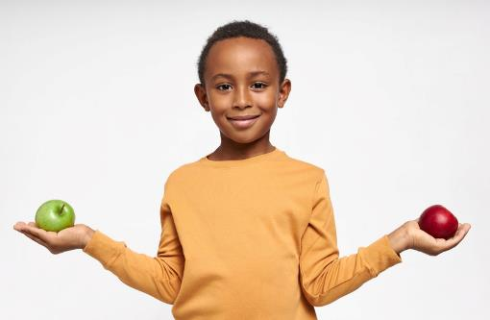
Get at least 5 A DAY – canned and frozen count too
Why do we need fruit and vegetables?
How much do we need?
At least 5 portions a day!
How much is a portion?
About what fits into the palm of your hand.
fibre!
For vitamins, minerals and...

Slide 8
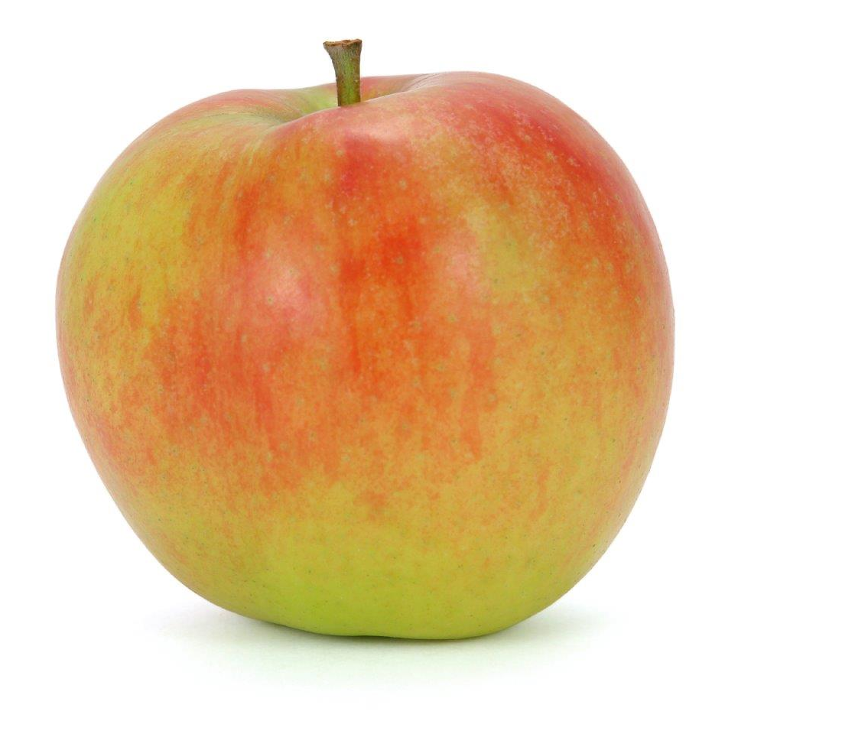
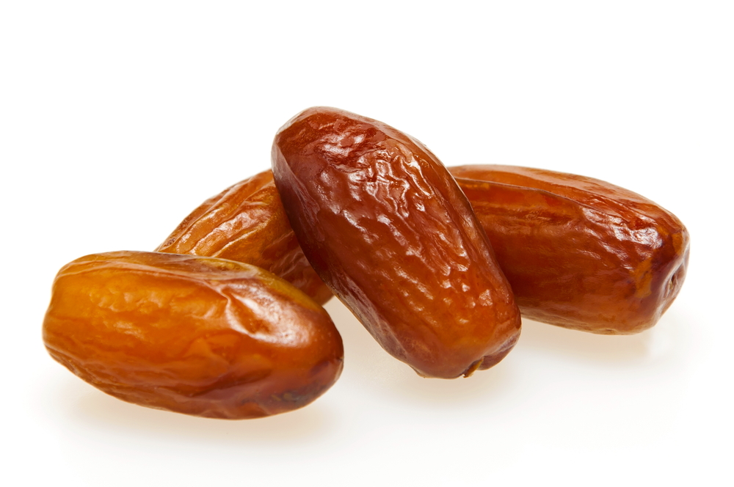
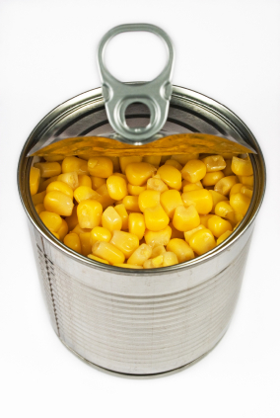
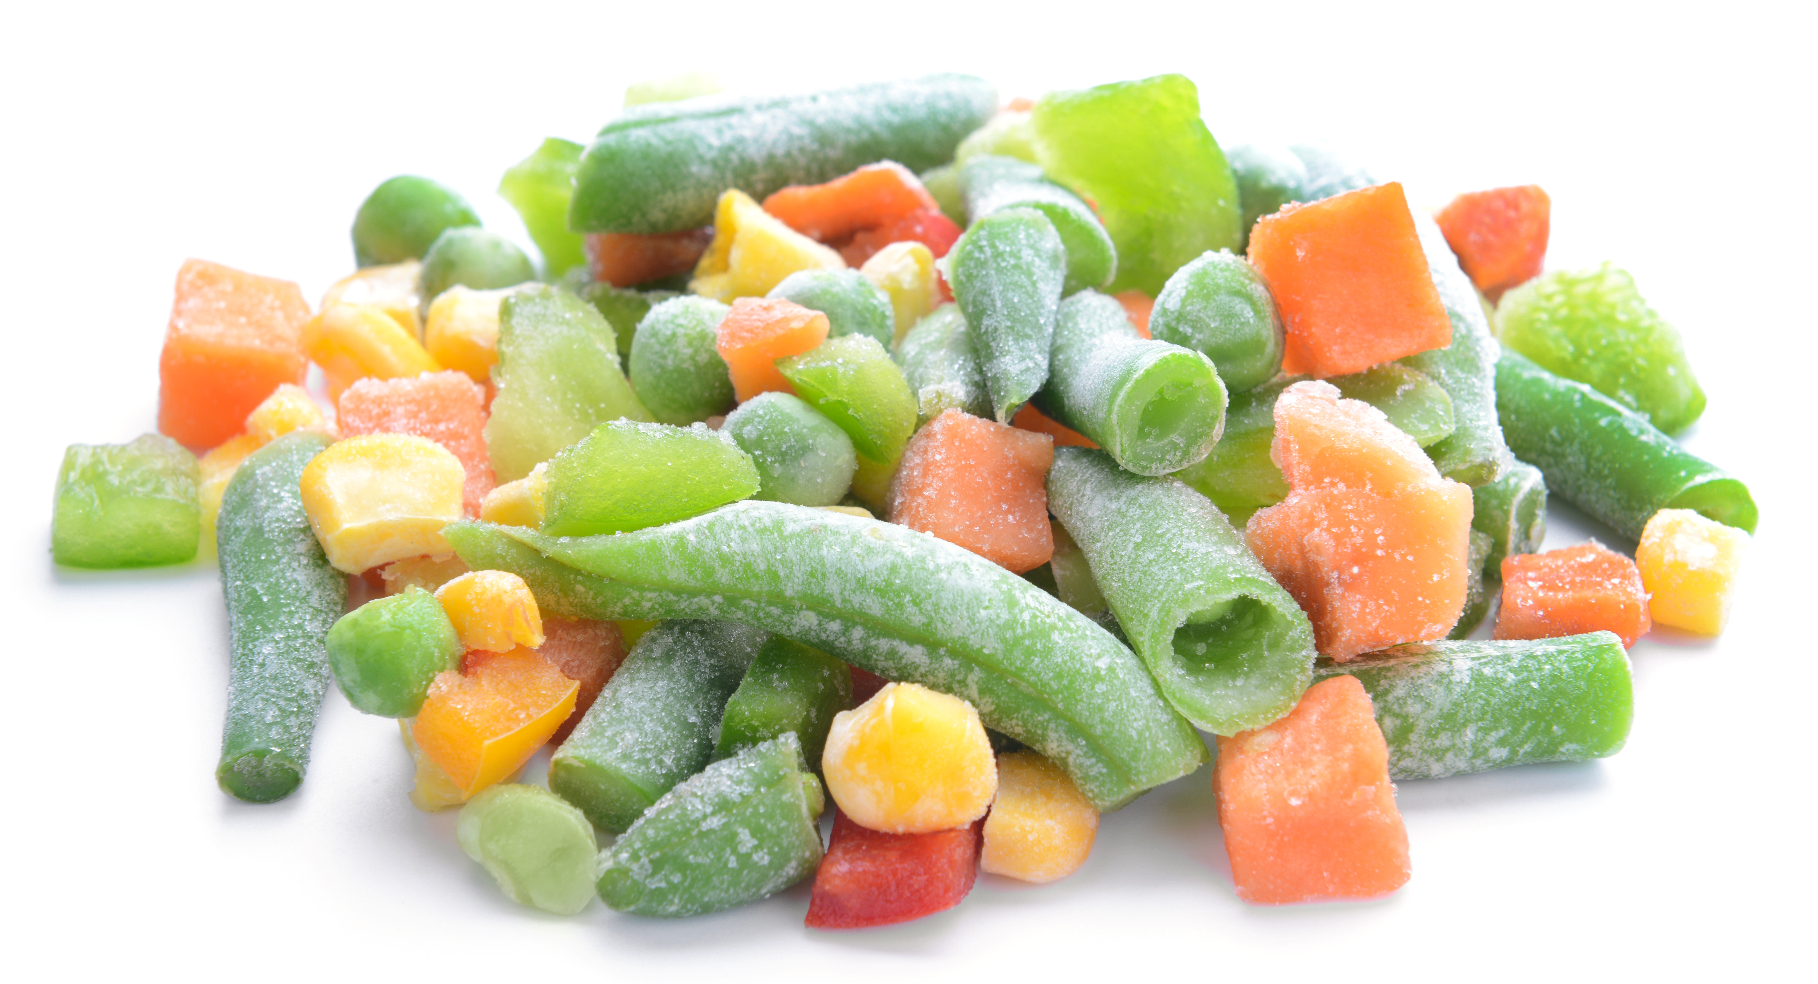
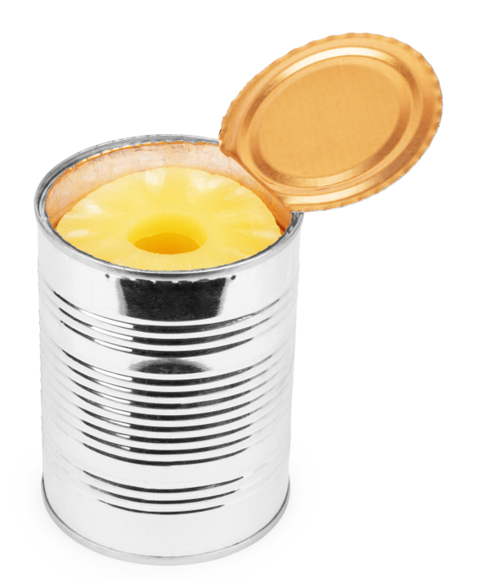
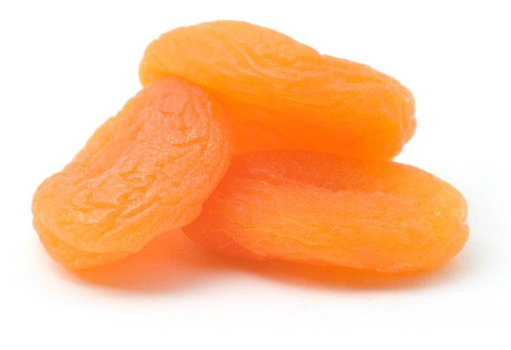
Get at least 5 A DAY – canned and frozen count too
What counts?
Canned and frozen types are handy because they can be ready in the freezer or cupboard at anytime!
Fresh, frozen, dried and canned all count.
Can you think of some examples for each type?
Fresh | Frozen | Dried | Canned
They can cost less too!

Slide 9
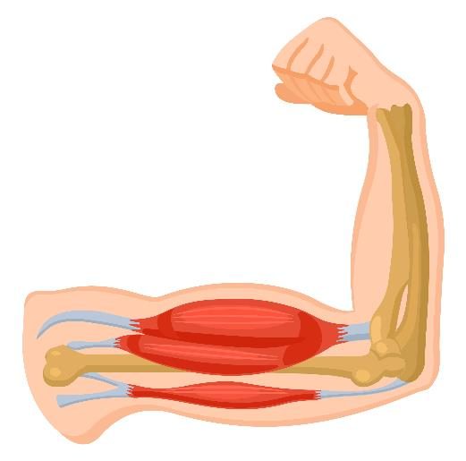
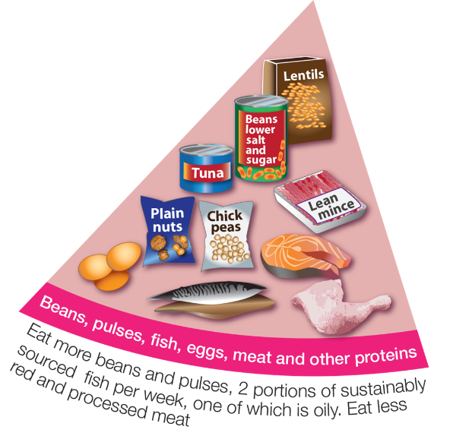
Vary your protein – be more creative
Why do we need protein foods?
What foods provide protein?
To help muscles and bones grow.
What foods can you see here?

Slide 10
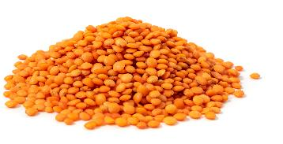
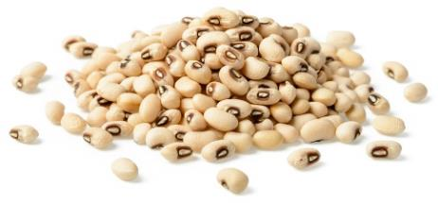
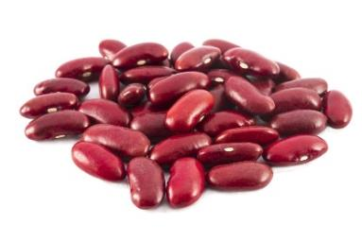
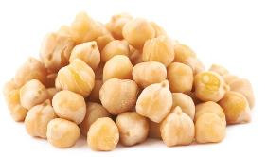
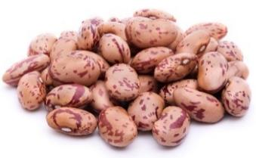
Vary your protein – be more creative
We should vary our protein and have protein foods from plants more often.
Can you name these protein foods from plants?
Red lentils
Black eyed beans
Red kidney beans
Which of these have you tried?
Chickpeas
Pinto beans

Slide 11
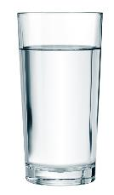
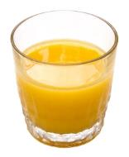
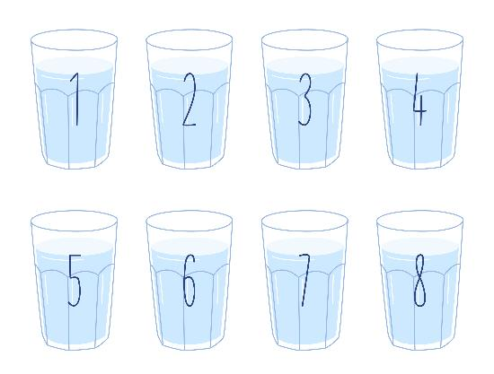
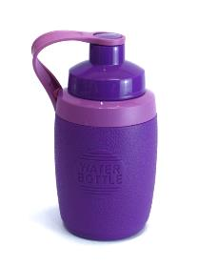
Stay hydrated – fill up from the tap
How much do we need to drink each day?
What are healthier drink choices?
Use reusable drink containers, like...
About 6-8 drinks a day.
or recyclable drink containers!

Slide 12
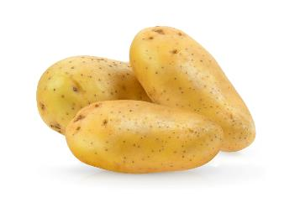
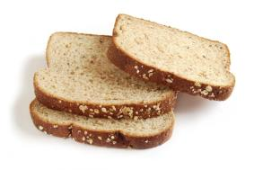
Reduce food waste – be food wise
What three foods do you think are wasted the most?
Why is it important to reduce food waste?
To look after our planet.
Land, water and energy are used to make our food. When food is wasted, it means these resources are wasted too.
To save money.
Potatoes, bread and milk.

Slide 13
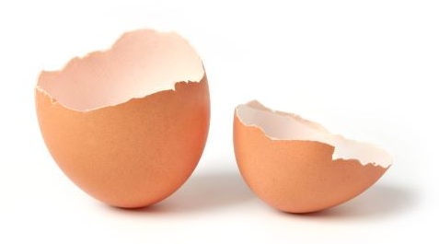
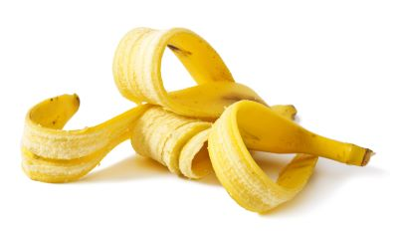
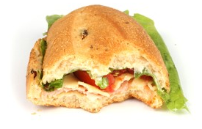
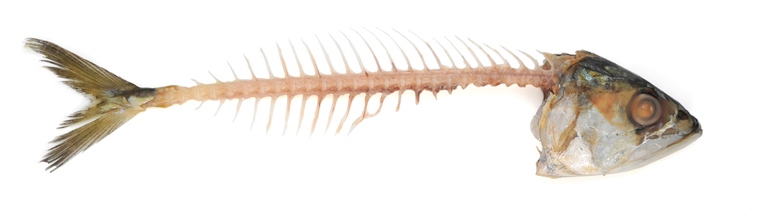
Reduce food waste – be food wise
Which of these should be in the food waste bin?
Food waste bin
Could have been saved

Slide 14
Reduce food waste – be food wise
Everyone has wasted food at some time.
Here are some reasons that people have given for wasting food.
I’ve put too much food on my plate and I can’t eat it all.
I don’t like this food, so I don’t want to eat it.
What tips could you give each person to help them waste less food in the future?
This food is going bad so I have to throw it away.

Slide 15
Reduce food waste – be food wise
What food have you wasted in the past?
How could you reduce food waste in the future?
Take a smaller portion.
Share a portion that is too large.
Ask to try a little bit of a food if you’re not sure you will like it.
Save it for later. (Remember, it may need to be wrapped up or put in the fridge so it stays good, or safe, to eat.)
Here are some ideas!
Visit Love Food Hate Waste for more ideas!

Slide 16
Remember!
Everyone can do something to eat better.
What could you do?
Have a great Healthy Eating Week!
Let us know what you are doing on twitter @NutritionOrgUK #HEW23 or email us at education@nutrition.org.uk

Slide 17
How many food characters did you spot?

