Slide 1
British Nutrition Foundation Healthy Eating Week 13 – 17 June 2022
SOCIAL MEDIA PACK

Slide 2
Welcome to the 10th anniversary of British Nutrition Foundation’s Healthy Eating Week.
This year we are celebrating Healthy Eating Week between 13 - 17 June 2022 and the key message for the Week is Eat well for you and the planet! with the five following themes for each day of the Week:
Monday: Focus on fibre - for meals and snacks
Tuesday: Get at least 5 A DAY - put plenty on your plate
Wednesday: Vary your protein - be more creative
Thursday: Stay hydrated - fill up from the tap
Friday: Reduce food waste - know your portions
This social media pack contains content suggestions for posts in the run up to the Week as well as the Week itself. Suggested graphics and other available graphics (shown within this pack) are available to download from our website.
We hope this pack allows you to simply and proudly spread the word about your involvement with Healthy Eating Week across your social media channels. In any social media posts please tag the British Nutrition Foundation (Twitter and LinkedIn handles below), include #HEW22 and where possible refer to the Week as the British Nutrition Foundation’s Healthy Eating Week.
You can find us on Twitter @NutritionOrgUK and LinkedIn
For more information and to download further free resources, visit https://www.nutrition.org.uk/healthy-eating-week/

Slide 3
Table of contents
Content | Slide No.
Social media content for Before the Week | 5 – 7
Social media content for the Week (13 - 17 June) | 8 - 12
Social media post for After the Week | 13
Overview of available graphics | 15 - 17

Slide 4
Social Media Posts - each of these posts can be used across all social media including Twitter, LinkedIn, Facebook & Instagram

Slide 5
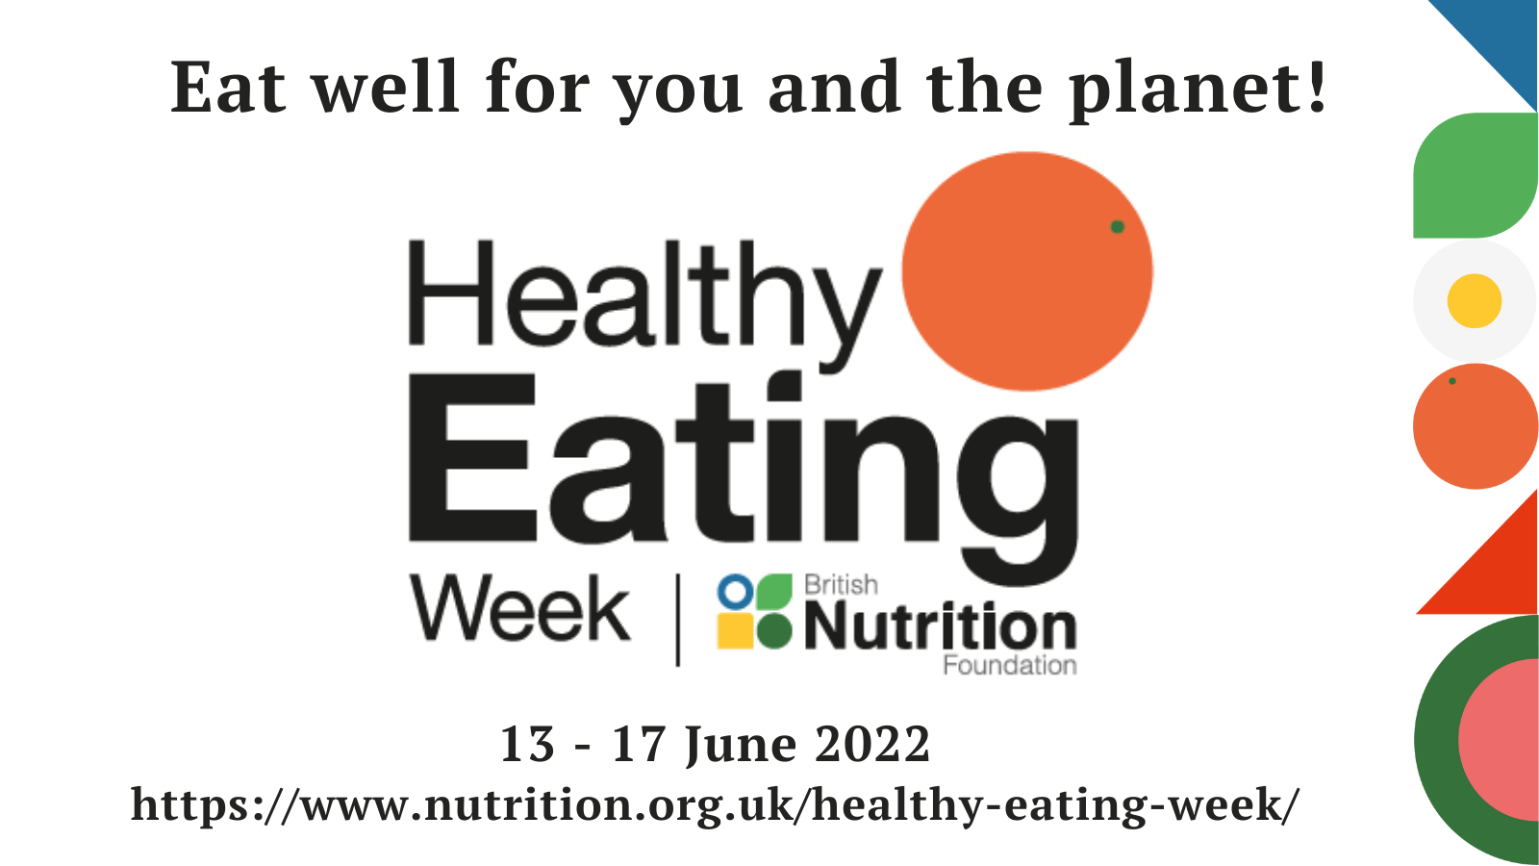
Before the Week – Social Media Post (1)
🤩Join us for British Nutrition Foundation's Healthy Eating Week #HEW22 @NutritionOrgUK
📅 When: 13-17 June 2022
🌍 Theme: Eat well for you & the planet!
🌟 There's something for everyone - free, downloadable resources, guides & challenges
✏️Register https://www.nutrition.org.uk/healthy-eating-week/register-for-2022/
This graphic is available to download from: https://www.nutrition.org.uk/healthy-eating-week/media-pack/graphics-and-images/

Slide 6
Before the Week – Social Media Post (2)
Are you looking for simple steps towards a healthier & more sustainable diet?
Join us for the British Nutrition Foundation's Healthy Eating Week 13-17 June '22 & use the free guides & resources to support you! #HEW22
Register ⬇️
https://www.nutrition.org.uk/healthy-eating-week/register-for-2022/
@NutritionOrgUK
This graphic is available to download from: https://www.nutrition.org.uk/healthy-eating-week/media-pack/graphics-and-images/

Slide 7
Before the Week – Social Media Post (3)
We’re thrilled to be taking part in the British Nutrition Foundation's Healthy Eating Week on 13-17 June 22 to learn more & get tips on how to ‘Eat well for you & the planet!’ #HEW22
Join us & register here: https://www.nutrition.org.uk/healthy-eating-week/register-for-2022/
@NutritionOrgUK
This graphic is available to download from: https://www.nutrition.org.uk/healthy-eating-week/media-pack/graphics-and-images/

Slide 8
Day 1 / Mon 13 June – Focus on fibre
To kick off Healthy Eating Week #HEW22 we’re focusing on #fibre by switching to wholegrains like wholemeal bread, wholewheat pasta & brown rice. A simple swap helping us get closer to the 30g/day fibre recommendation!
https://www.nutrition.org.uk/healthy-eating-week/
@NutritionOrgUK
This graphic is available to download from: https://www.nutrition.org.uk/healthy-eating-week/media-pack/graphics-and-images/

Slide 9
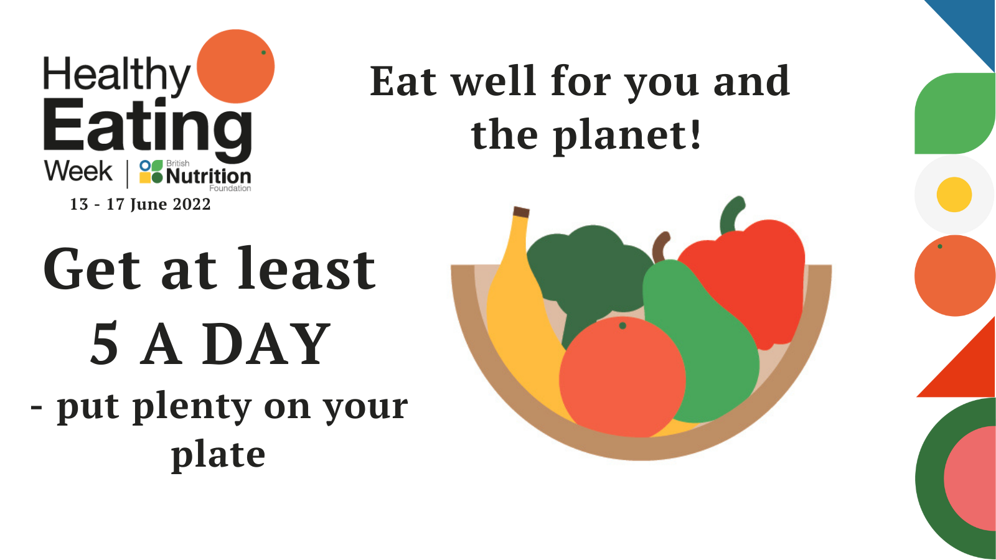
Day 2 / Tues 14 June – Get at least 5 A DAY
We are snacking on fruit & filling at least half our plate with veg to get more fruit & veg in our diet this Healthy Eating Week! #HEW22
Find out more at https://www.nutrition.org.uk/healthy-eating-week/
@NutritionOrgUK
This graphic is available to download from: https://www.nutrition.org.uk/healthy-eating-week/media-pack/graphics-and-images/

Slide 10
Day 3 / Wed 15 June – Vary your protein
Everyday this Healthy Eating Week #HEW22 we're aiming to get our protein from a variety of sources, by being creative with beans, lentils, chickpeas & tofu.
Chicken, chickpea & spinach curry, or tuna & cannellini beans salad anybody?
https://www.nutrition.org.uk/healthy-eating-week/
@NutritionOrgUK
This graphic is available to download from: https://www.nutrition.org.uk/healthy-eating-week/media-pack/graphics-and-images/

Slide 11
Day 4 / Thurs 16 June – Stay hydrated
Switching from a single use plastic bottle to a reusable water bottle that we can fill up from the tap is one way we're staying hydrated while also reducing plastic waste this Healthy Eating Week #HEW22
To find out more visit https://www.nutrition.org.uk/healthy-eating-week/
@NutritionOrgUK
This graphic is available to download from: https://www.nutrition.org.uk/healthy-eating-week/media-pack/graphics-and-images/

Slide 12
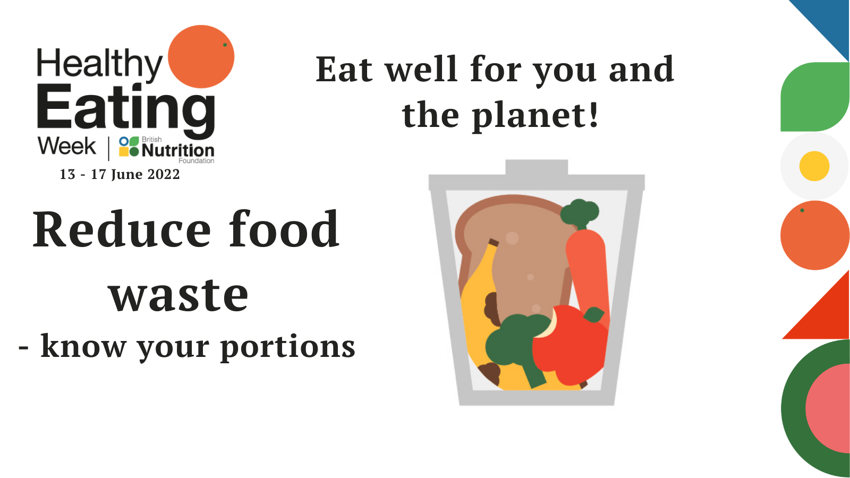
Day 5 / Fri 17 June – Reduce food waste
It's the final day of Healthy Eating Week #HEW22 & today we'll be taking steps to reduce the amount of food we waste by freezing any leftovers, planning our meals & writing our shopping lists.
Find out more at https://www.nutrition.org.uk/healthy-eating-week/
@NutritionOrgUK
This graphic is available to download from: https://www.nutrition.org.uk/healthy-eating-week/media-pack/graphics-and-images/

Slide 13
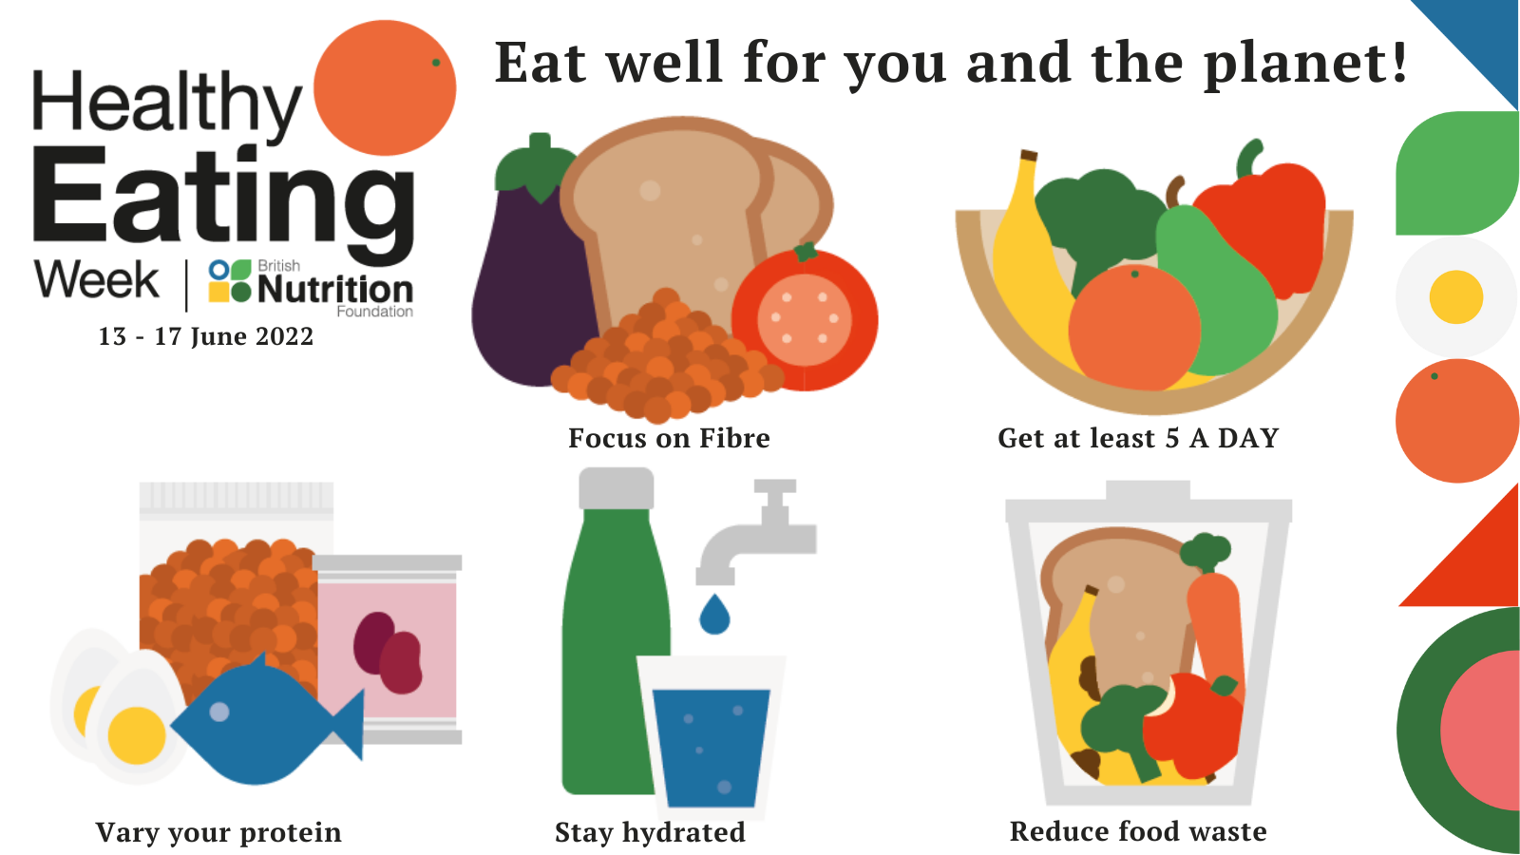
After the Week
Our Healthy Eating Week #HEW22 was full of challenges that were fun, easy to get involved in & helped us all make simple changes towards a healthier & more sustainable diet – changes that can form lifelong habits!
For more info visit https://www.nutrition.org.uk/healthy-eating-week/
@NutritionOrgUK
This graphic is available to download from: https://www.nutrition.org.uk/healthy-eating-week/media-pack/graphics-and-images/

Slide 14
Overview of Available Graphics

Slide 15
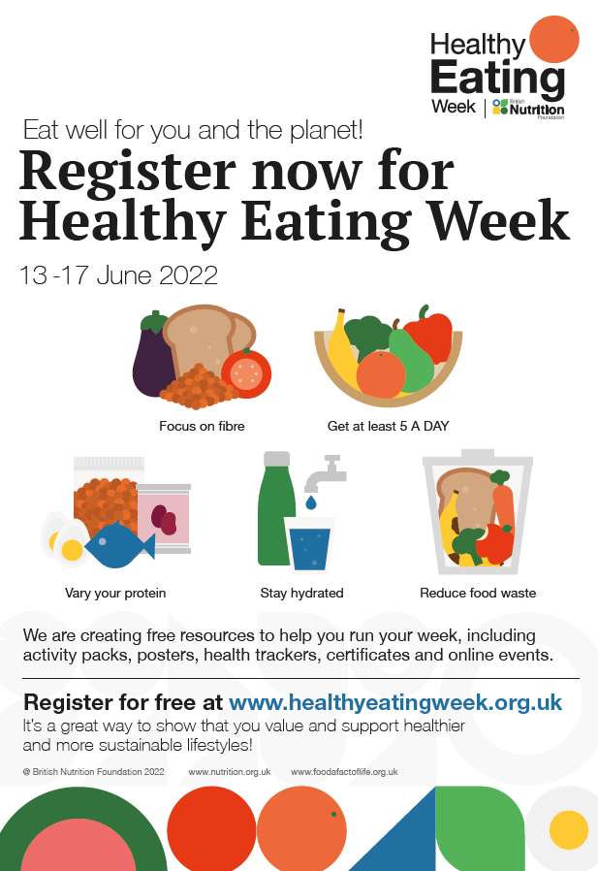
Graphics
promotional flyer
tiles for social media posts
available to download from https://www.nutrition.org.uk/healthy-eating-week/

Slide 16
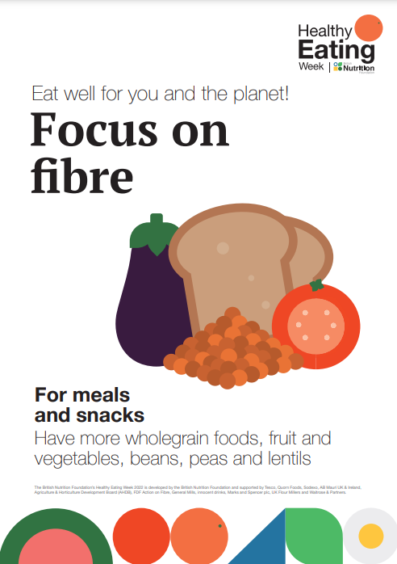
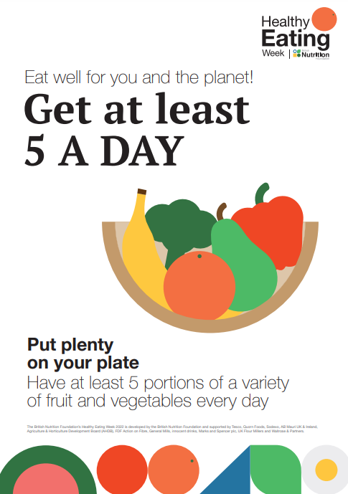
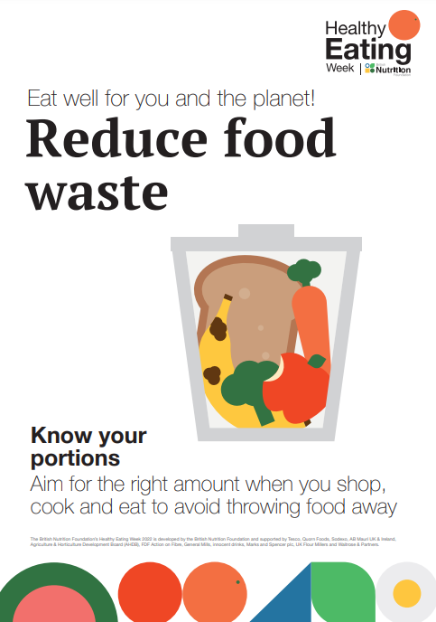
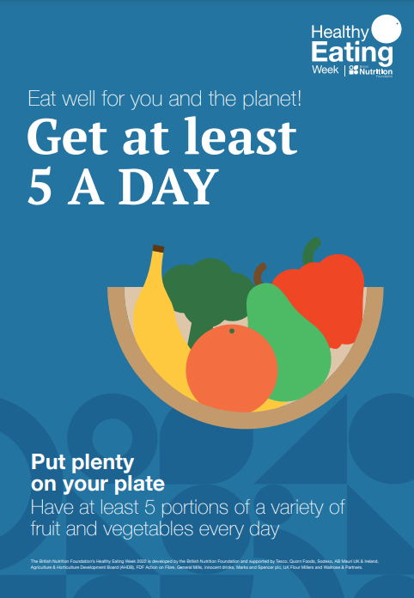
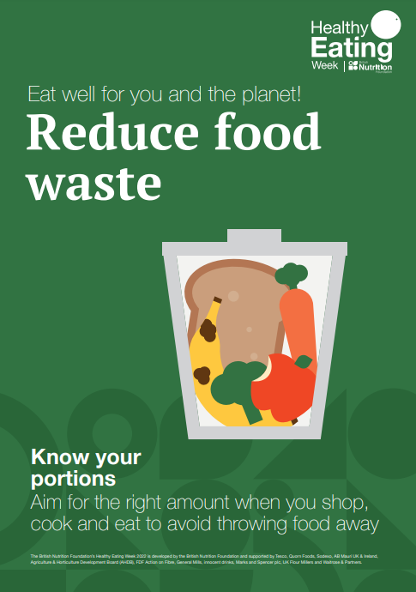
Graphics – Daily Theme Posters
Available to download from https://www.nutrition.org.uk/healthy-eating-week/what-s-it-all-about/posters/

Slide 17
Graphics – Daily Theme Icons
Available to download from https://www.nutrition.org.uk/healthy-eating-week/what-s-it-all-about/icons/

Slide 18
Thank you!

