Slide 1


Strategy 2023-28
January 2023

Slide 2
About Us

Slide 3
Who we are
Board of Trustees, Honorary President
Advisory Committee
Scientific Committee
BNF Team
Editorial Advisory Board
Academy of Nutrition Sciences
Education Working Groups
BNF Student Network

Slide 4
Context

Slide 5
Our track record
1991 Food,
2020s
Founding partner of the Academy of Nutrition Sciences.
Almost 2.5m used our website, and more than 1/2m teachers accessed FFL.
48 corporate members
35,000 Twitter/LinkedIn followers
2010s
2010 Agriculture & Horticulture Development Board partnership
2012 Behaviour Change Conference
2012 Drummond Memorial Fund.
2013 Health Eating Week
2017 50th Anniversary
90s & 00s
70s & 80s
1991 Food, A Fact of Life.
Task Force reports on Clinical Nutrition; Obesity; Oral health; Heart health, and Plants, diet and health.
1967 The British Nutrition Foundation
1968 Nutrition Bulletin
1988 Royal Patron appointed
1989 1st Education Conference

Slide 6

Challenges
Widening health inequalities
Obesity
Sustainability and climate change
Changing consumer behaviour / Cost of living

Slide 7
Our Strategy

Slide 8
Our Strategic Ambition
We want a future where everyone has a healthy, sustainable diet.
Our ambition is that by 2028, we will have doubled our reach and evidenced our contribution to healthier, more sustainable diets by demonstrating both our impact on the food environment and on consumer knowledge, skills and motivation, and so contribute to changing behaviour.

Slide 9
Principles
We are impartial, evidence-led and driven only by our commitment to the public benefit.
We are clear when we are commercial and when we are working on our charitable purpose.
In our consulting work, we work with clients and members only as part of a meaningful and authentic commitment to nutrition.
We are digital-first with an understanding of the consumer at the heart of our communications, using data collection to generate insights and deepen engagement and scale our impact.
We recognise that the science base and the food industry is global and we reflect this.
We invest in evaluation and will measure and report upon our impact.

Slide 10
Our Values
Integrity
We are science-led, impartial, open minded, transparent and committed to diversity and sound ethical principles.
Collaboration
We amplify our impact via partnership working with a range of stakeholders.
Quality
We are a team of highly qualified experts who deliver excellence, consistently.
Positivity
We care about providing credible nutrition science and are passionate about the positive impact it can have on healthier lives.

Slide 11

We are a charity.
Our objects :
to advance the education of the public and those involved in training and the education of others in nutrition
to advance the study of and research into nutrition for the public benefit, and disseminate and publish the useful results of such research.
Nutrition.org.uk, media and social media.
Webinars & training for food teachers; healthcare professionals, public health practitioners and an interested public.
Healthy Eating Week
Food, A Fact of Life & supporting teachers
BNF Drummond Awards programme
Nutrition Bulletin

Slide 12
Priorities
1
2
3
Changing the Food Environment
Educating People
Advocating Science and Building Consensus

Slide 13
Enabled by…
1
2
A great place to work, and work with
Sustaining our organisation

Slide 14

The importance of environment
An over-emphasis on individual responsibility.
Where we live and what we earn radically shapes the options available to us in terms of food and activity.
Access to a healthy, sustainable diet is impacted by what we can afford, our social networks and community, and by the food environment we experience.

Slide 15
Changing the Food Environment
We will:
Deepen our engagement with members, to help corporate nutritionists deliver healthier, more sustainable products in their businesses.
Broaden our membership, where membership is part of a meaningful and authentic commitment to healthy, sustainable diets.
Advocate to change the food environment in schools, partnering with campaigners seeking to make free school meals accessible to all.
Over next 2-3 years, extend our work with markets/members outside the UK.
Evidence our impact through case studies.
Invite feedback after every project, programme or intervention.

Slide 16

Educating People
We will focus on 4 vulnerable groups:
Low income families with children
Direct to consumer - web, social, content marketing, media and social media.
Schools.
Healthy Eating Week
Via our members and partners; webinars, and HCP content.
Young adults 15 – 25
Women around menopause
Older adults living independently or in care settings (healthy ageing)

Slide 17
Advocating Science and Building Consensus
We will:
Publish more thought-leadership pieces and rapid evidence reviews.
Convene stakeholders and build consensus on key strategic topics.
Continue to develop Nutrition Bulletin
Continue to advance the study of and research into nutrition for the public benefit – Drummond Awards Programme.

Slide 18

Enablers
We will:
Be a learning organisation and demonstrate our commitment to evaluation through impact reporting and publication.
Invest in developing our people and seek to be ‘a great place to work’.
Live our values.
Evidence our commitment to equity, diversity and inclusion.
1
A great place to work, and work with

Slide 19
Equity, diversity and inclusion
Our EDI Strategy outcomes:
The principles of equity, diversity and inclusion are embedded in the whole organisation and help to deliver our charitable aims.
Our work is designed to be accessible to all.
The British Nutrition Foundation has a greater impact because it reflects different perspectives, experiences and skills, including from people who access our information and advice and training, our external stakeholders and members.

Slide 20
How will we measure success?
Headline KPIs
Doubling reach (web, social, training and webinars)
Publishing Impact Case Studies
Reputation (including of Nutrition Bulletin)
Member and funder feedback (Net Promoter Score)
Income growth
Employee engagement and EDI

Slide 21
Working with Members

Slide 22
Strategy through implementation
Strategic partner: critical assessment, gap analysis, strategic projects & thought leadership.
Corporate affairs: horizon scanning; risk assessment; research synthesis and consensus building. Global perspective.
Technical and regulatory support (includes placements/ internships % employee training)
Communications (media, content, social & internal comms)
Campaign partner (public facing)

Slide 23
How members can help us reach our goals
Doubling reach
  weblinks, social media sharing, internal comms channels, campaigns, in-kind support)
Publishing Impact Case Studies:
  We will be asking for your assessment of whether the work we do makes a difference in your business, and with your stakeholders
Member and funder feedback
  After every project
Income growth
  Supporting our charitable work programme
Employee engagement:
  Opportunities to share learning (secondments, shadowing, workshops).

Slide 24
Science vision 2023-28 within the new Strategy

Slide 25
Our Science vision
Key objectives
To be a leading source of sound science for those searching for balanced, up to date views on topical areas of nutrition.
To support BNF’s journey to work more digitally and become more consumer focussed.
To support key professionals that influence the health and social care of communities and produce relevant, topical training and resources that increase recognition of our value to our key stakeholders.
To develop new partnerships/joint projects with corporate members to create a healthier and more sustainable food environment and better evaluate our work with them.
To become more global, increasing our reach in Europe and beyond.

Slide 26
British Nutrition Foundation Heatmap (December 2022)
CONFIDENTIAL
INTEREST/IMPORTANCE | Highest | Healthy dietary patterns incl. Government guidelines (Eatwell Guide) Nutrient profiling/nutrient density Energy density Food education Nutritional challenges/inadequacies among children, teenagers & students | Personalised nutrition & data to provide diagnostics Sweeteners (WHO position) & sweetness Workplace wellbeing & ESG Healthy ageing incl. cognitive decline, joint health & eye health Diet & menopause Biofortification incl. folic acid | Food insecurity incl. impact of cost-of-living crisis, inequalities, vulnerable groups & free school meals Sustainability incl. plant-based, red meat/dairy debate Obesity & weight management
 | Mid | Healthy Lifestyles (physical activity, sleep) Fats and Health Obesity prevention early years incl. feeding style Salt Global dietary guidelines Diet and attainment/behaviour in children | Ultra-processed foods Food technology & innovation (incl. alternative/innovative proteins & genome editing) Gut microbiome Sustainability incl. supply chain (farm to fork), effect of climate on nutrition Vitamin D | Regulations on HFSS advertising and promotion Labelling incl. ecolabelling Mental Health – depression, anxiety, stress & wellbeing Eating behaviours incl. mindful, intuitive, chrono-nutrition, fasting, intermittent fasting, snacking
 | Lower | CBD & adaptogens Energy drinks Allergies and intolerances Nutrition curriculum for medical training | Micronutrients and inadequacies Caffeine Food safety incl. best before dates | Fad diets Superfoods Supplements
 |  | Possible | Very Likely | Occurring
 | LIKELIHOOD OF EMERGENCE
‘ Likelihood of emergence’ - Likelihood of issue emerging in the media space or resulting in the generation of policy action.
Possible: may become topical over the year Very likely: within next 6- 12 m Occurring: Has emerged into media/ policy space
‘ Interest/importance to BNF’ - Relevance of the topic to BNF’ s current activities/ plans, issues of public health importance, members, reputational r isk
Abbreviations: SSBs: sugar- sweetened beverages; LCS: low calorie sweeteners

Slide 27
A leading source of sound science
Reviews
Roundtables
Thought leadership reports
Nutrition Bulletin
Consensus statements
Position statements
Working groups/mini TFs (1-1.5y)
Joint papers (e.g. with ANS) (1y)
Opinion pieces (3-4m)
Virtual issues
Spotlights
Special issues
Commissioned reviews
Rapid reviews (6m)
In perspectives (6m)
In-depth reviews (1yr)
Yr 1: Menopause. Role for breakfast in children
Yr 2: Diet & Neurodiversity
Yr 1: UPF
Yr 2: Effect of sweeteners on the gut
Yr 1 Dairy foods: Controversies in health and sustainability. Personalised nutrition
Yr 2 How do we support the dietary needs of the older population? Are our dietary guidelines suitable for all (ethnicity)?
Yr 3 Global diet related policies – what works for obesity prevention? What EU policies have reduced nutritional vulnerabilities/inequalities?
Yr 1: Personalised nutrition

Slide 28
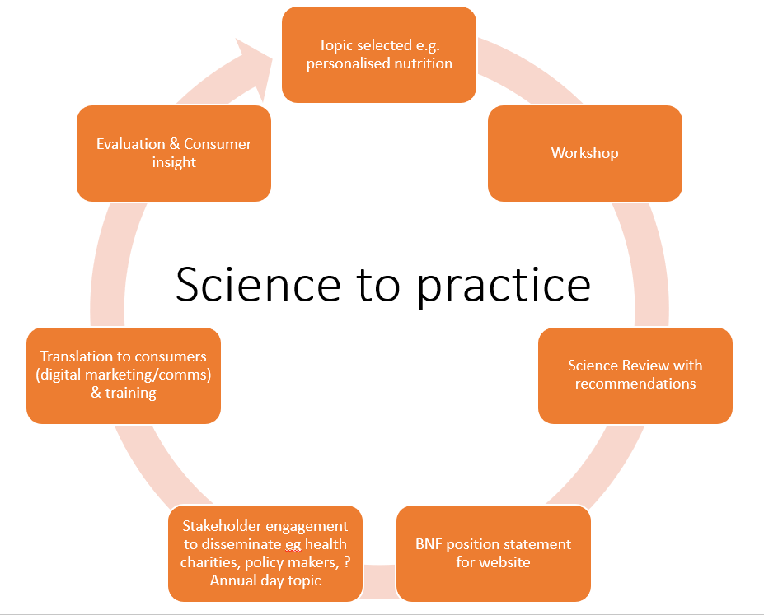
Producing practical resources/tools

Slide 29
Topical training and resources for key stakeholders
Webinars
Online
Standard
Interactive
Bespoke for members
Core (healthy eating lower & advanced, worksite health)
Courses for HCPs and others linked to CPD accredited as appropriate.
Ongoing CPD programme
5 short webinars to support non-nutritionists in industry
Worksite health
Standard package delivered by BNF
Healthy Eating
Lifestyle changes to support the menopause
Diet, lifestyle and your work performance

Slide 30

Becoming more global
Investigate ways to enhance our reputation internationally, building on the activities that are already providing geographical reach (e.g. Nutrition Bulletin, webinars).
Gain insight from our international EAB on key issues in other countries to ensure our thought pieces are widely relevant and support for ‘marketing’ of our reviews in their respective countries.
Extend the Scientific Committee to include international participants (US, EU, Africa, S America), setting up a small international working group to advise on topics of importance for BNF.
Ensure that roundtable events and workshops also encourage wider engagement.
Include presentations with international context within our CPD programme.
Reconnect with European Nutrition Foundations.

Slide 31
Championing nutrition science
STARt healthy – Stay Healthy: Aligning Public and Planetary Health Through Precision Plant-Based Dietary Solutions across the Life-course (The STAR Hub).
Translational Innovation Hub for Population Health using Sustainable Food and Nutrition Approaches (The RIPEN Hub).
UKRI: Raising the Pulse – 'Raising the Pulse' (RtP): Systems analysis of the environmental, nutritional and health benefits of pulse-enhanced foods.
UKRI: Food for added life years: Putting research into action (Food4Years) with the Diverse Nutrition Association, A mixed methods approach to look at relevant food strategies to reduce risk of malnutrition in older minority communities.
Disseminating important and relevant research (working with academics/researchers, publishing Nutrition Bulletin, webinars)
Stakeholder engagement
Partnerships with professional associations & societies (e.g. ANS)
Encouraging young people (e.g. via student network, internships)
Providing training (e.g. webinars) to support CPD, rewarding good practice and achievement (e.g. awards)

Slide 32
Questions?

