Slide 1
Pulses

Slide 2
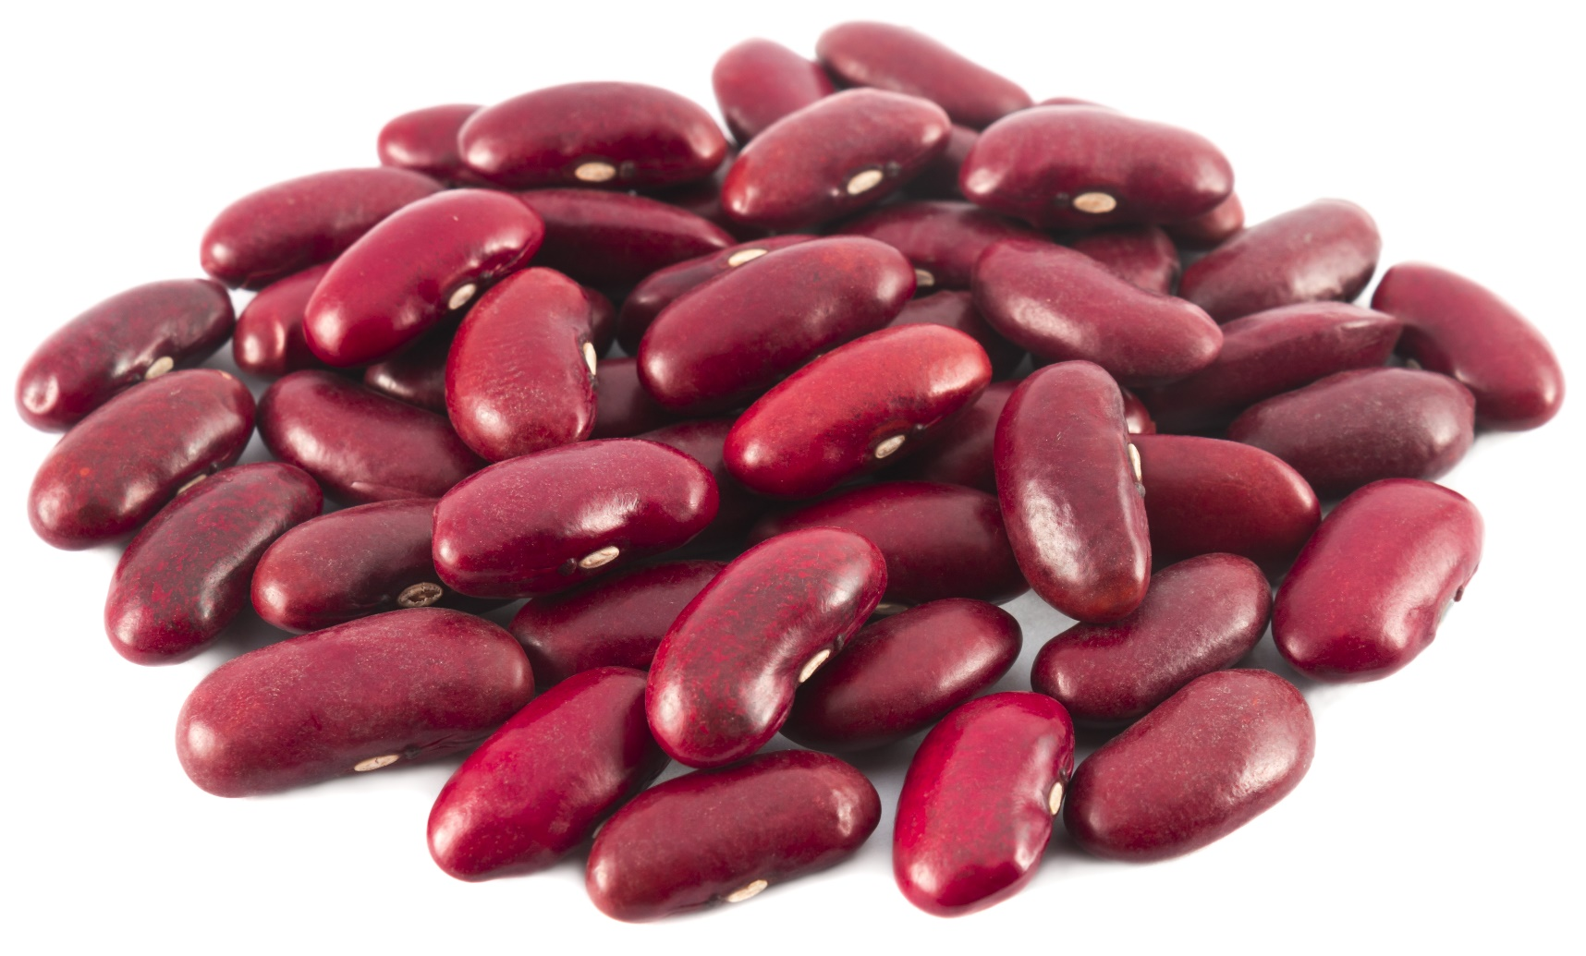
1.

Slide 3
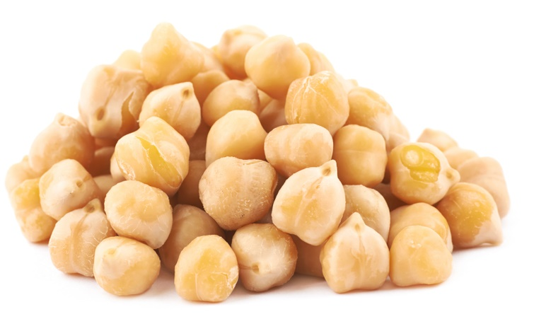
2.

Slide 4
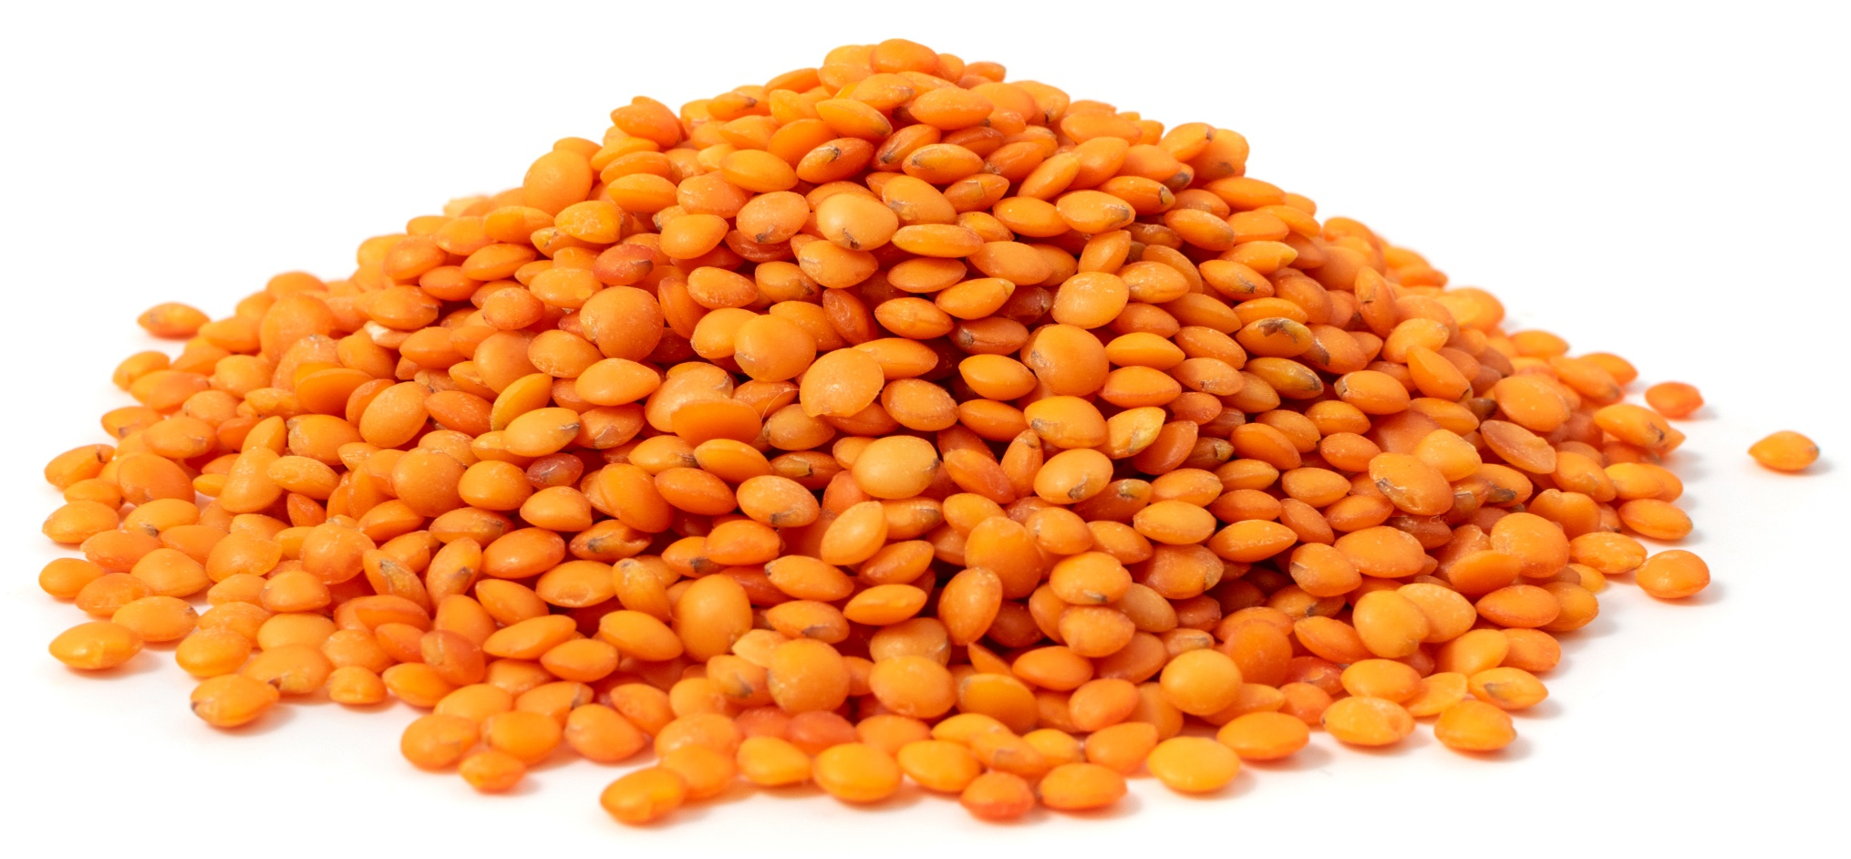
3.

Slide 5
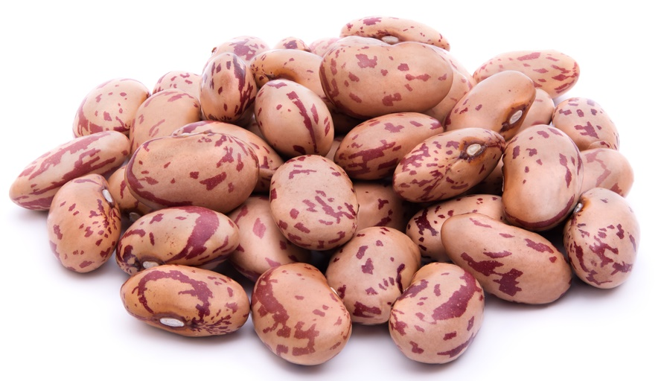
4.

Slide 6
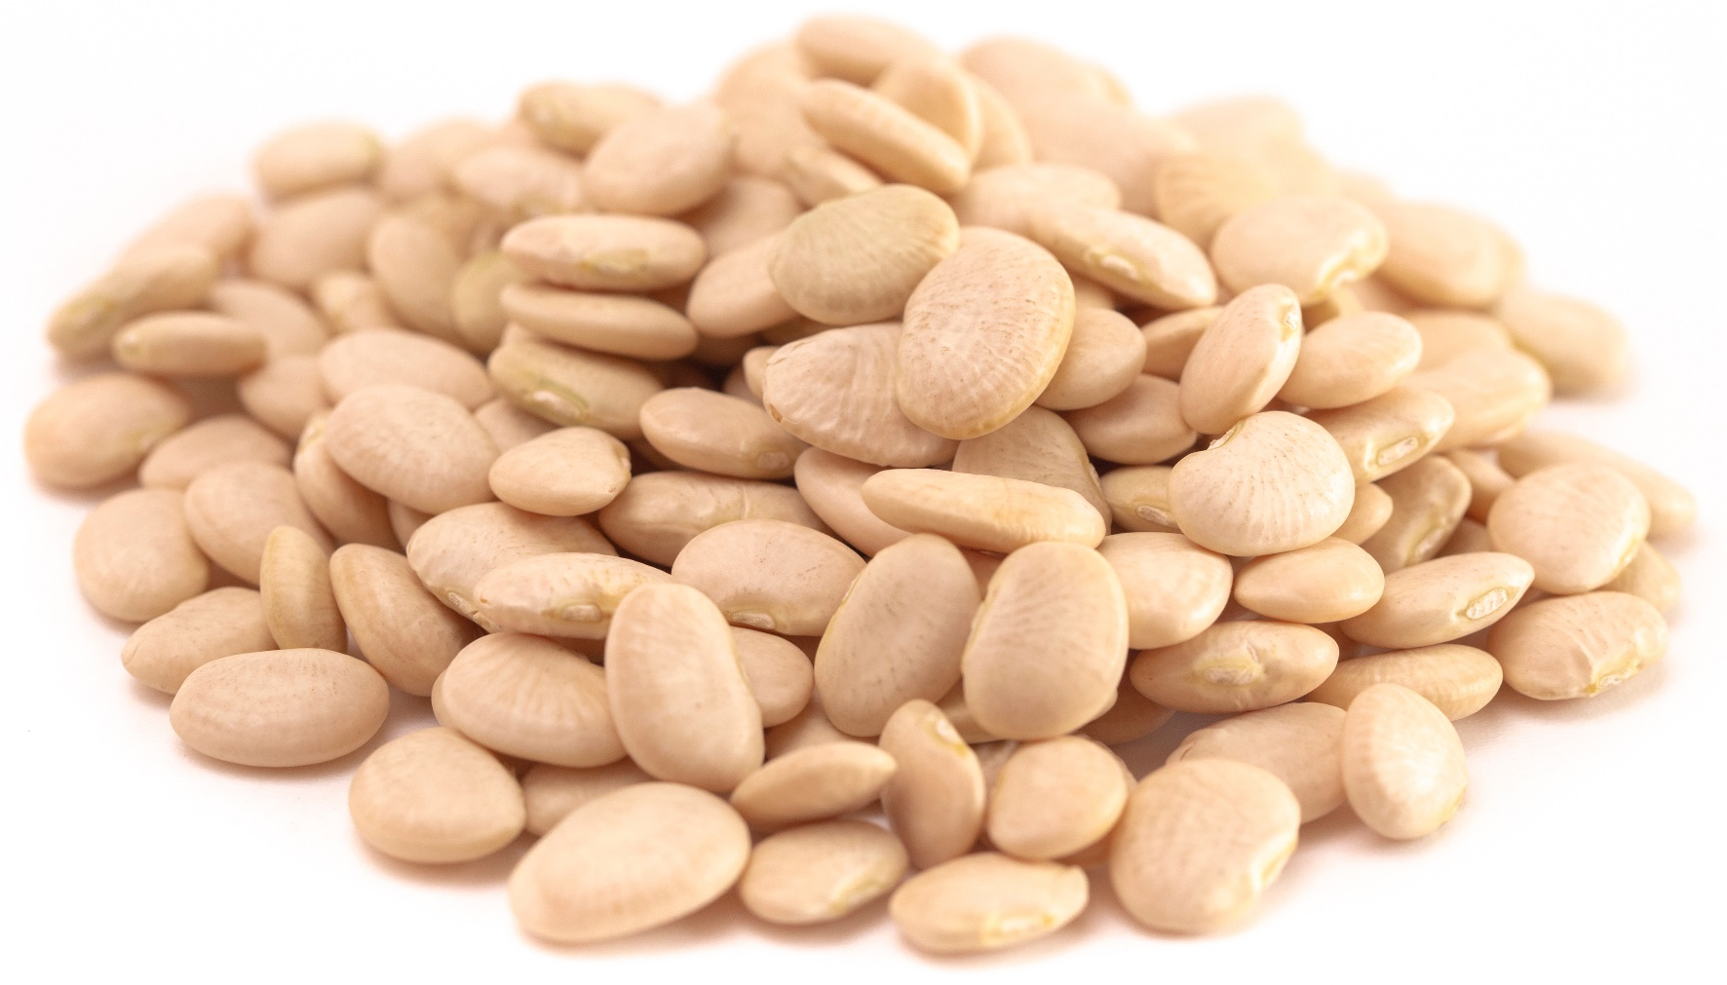
5.

Slide 7
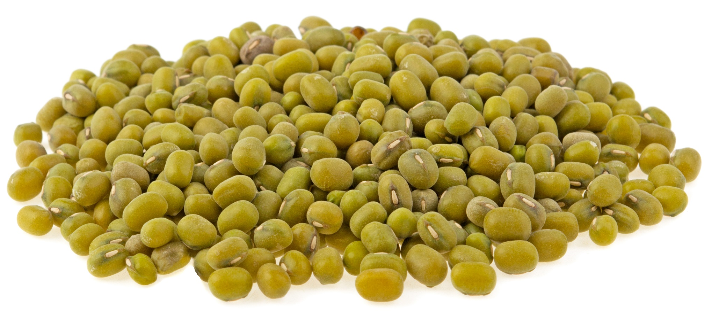
6.

Slide 8
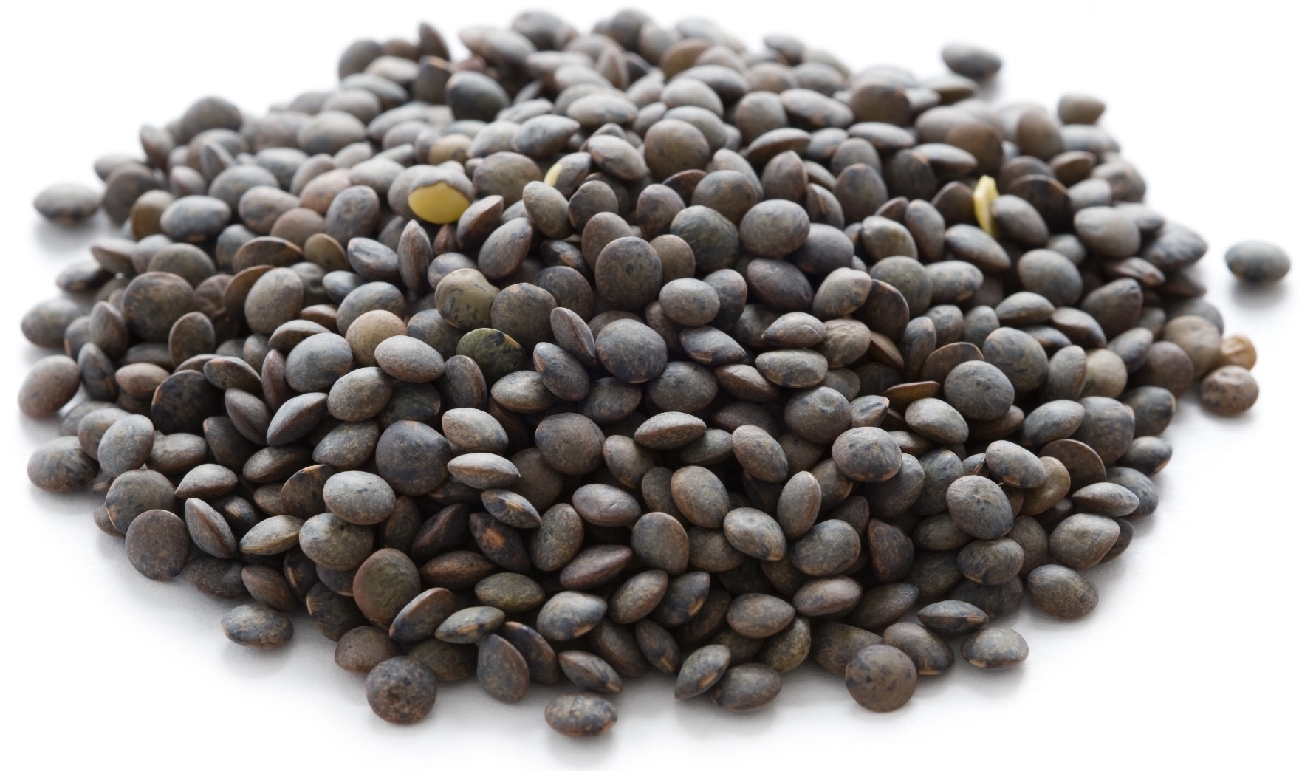
7.

Slide 9
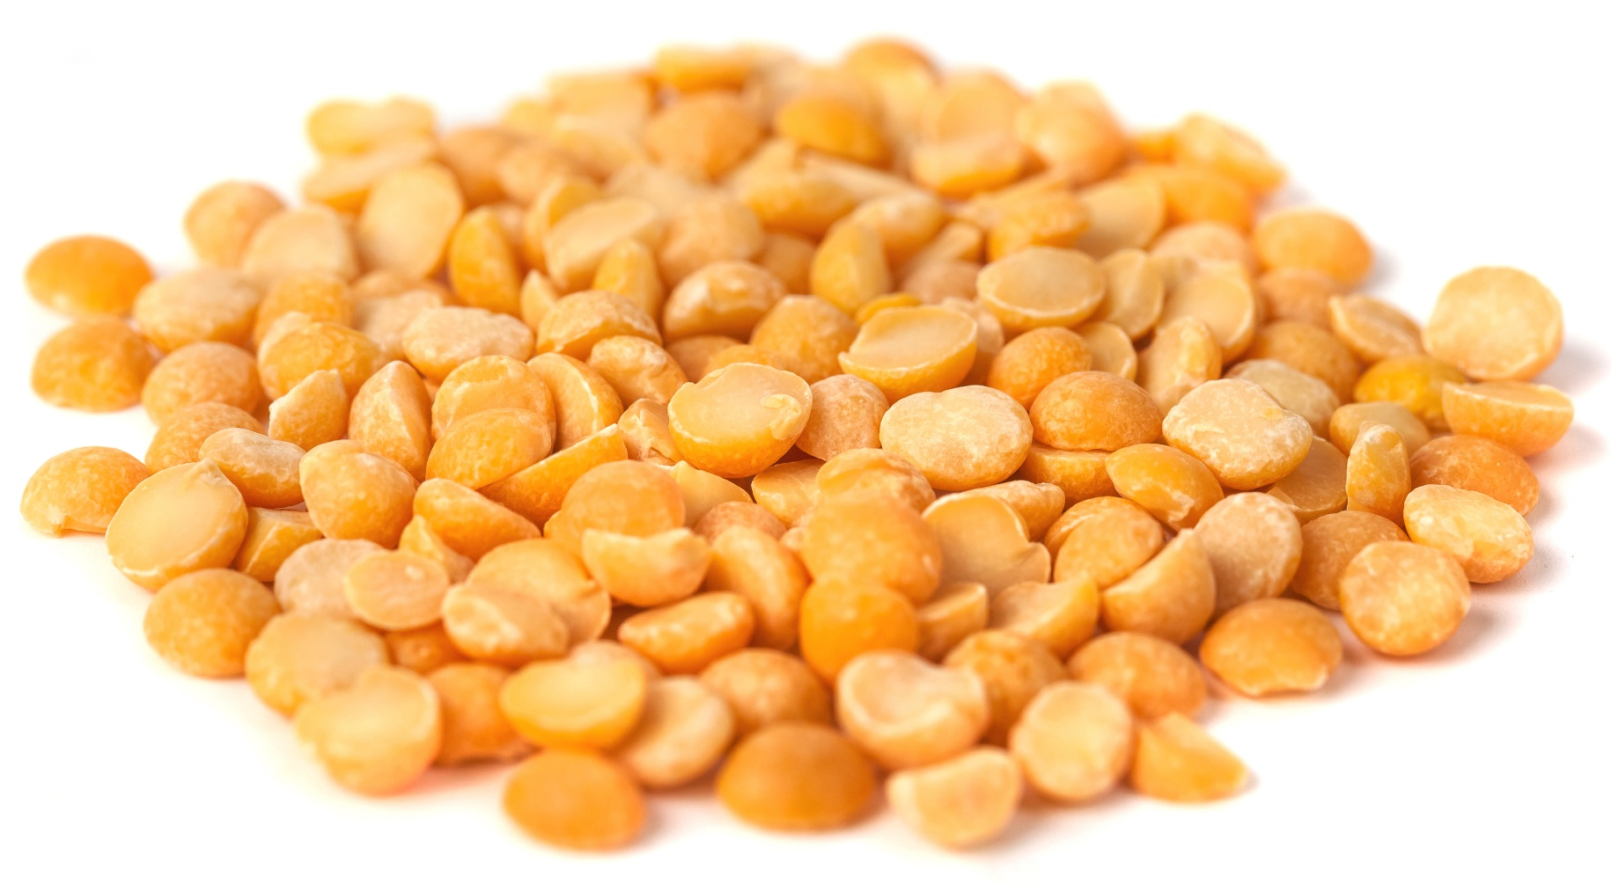
8.

Slide 10
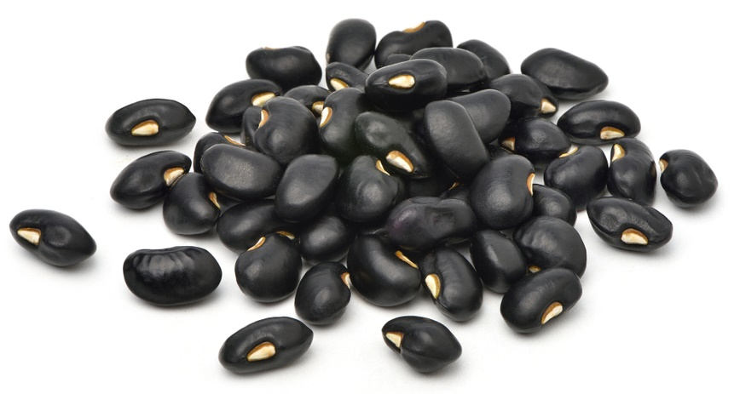
9.

Slide 11
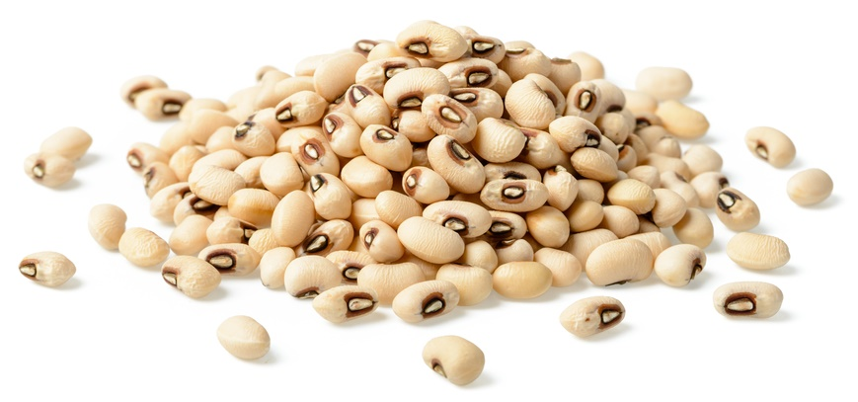
10.

Slide 12
Answers

Slide 13
1. Red kidney beans

Slide 14
2. Chickpeas

Slide 15
3. Red lentils

Slide 16
4. Pinto beans

Slide 17
5. Butter beans

Slide 18
6. Green lentils

Slide 19
7. Puy lentils

Slide 20
8. Yellow split peas

Slide 21
9. Black beans

Slide 22
10. Black eyed beans

Slide 23
Pulse labels
Black beans | Black eyed beans
Yellow split peas | Puy lentils
Green lentils | Butter beans
Red kidney beans | Red lentils
Pinto beans | Chickpeas

Slide 24
Pulses

