Slide 1
Eat well for you and the planet!
Primary school assembly

Slide 2
Eat well for you and the planet!
What does it mean to ‘Eat well for you and the planet!’?
Why is it important?
What can we do?

Slide 3
Eat well for you and the planet!
The foods and drinks we choose are important for our health and the health of the planet.

Slide 4
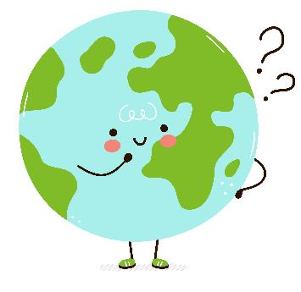
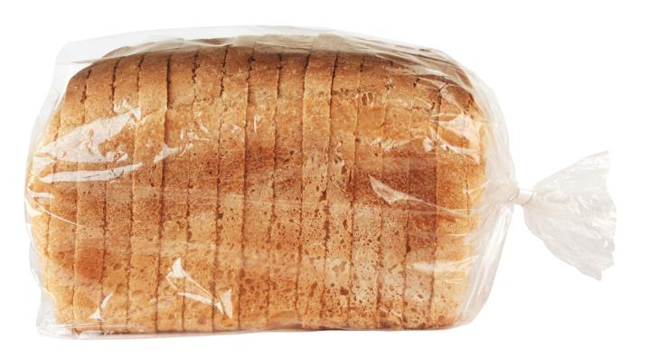
A lot goes into producing our food!
Land
Water
Energy
How would land, water and energy be used to make this loaf of bread?

Slide 5
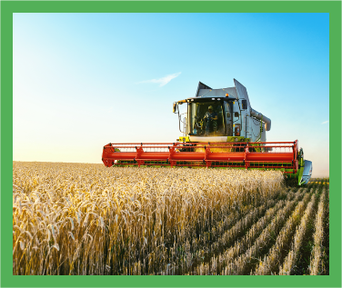
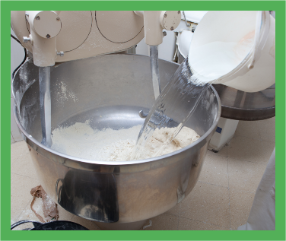
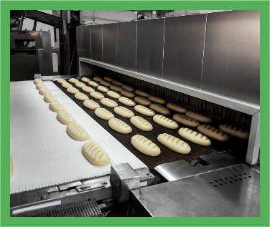
A lot goes into producing our food!
Land
Fuel
Transport
Water
Oven
Packaging

Slide 6
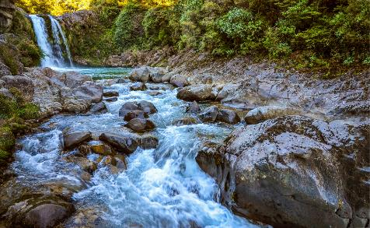
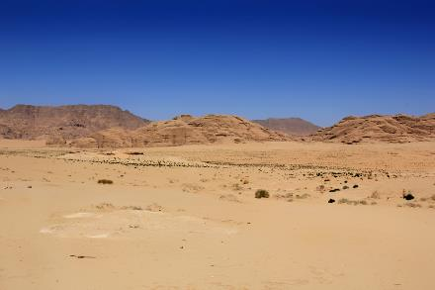
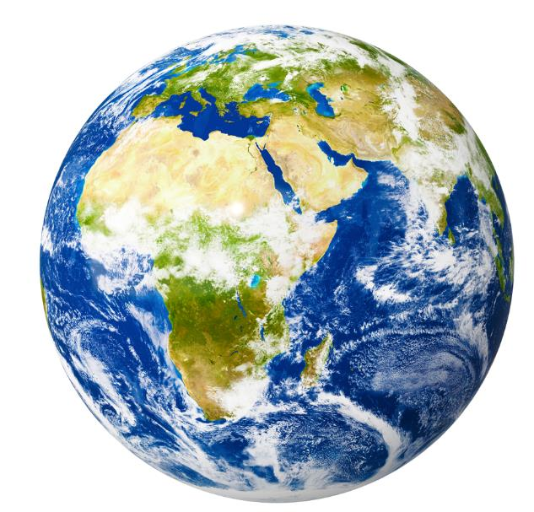
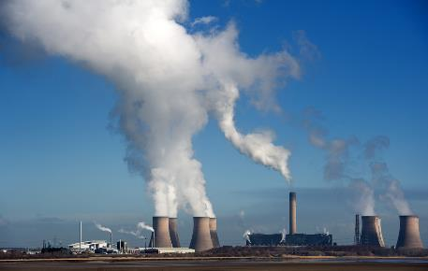
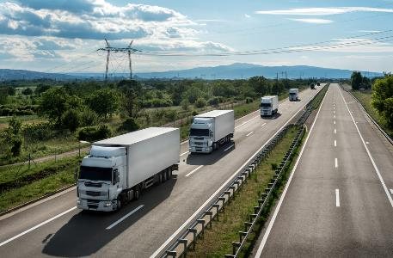
Why does it matter how much water, land and energy we use?
Fresh water is limited
Land is limited
The energy we need can create greenhouse gases (climate change)

Slide 7
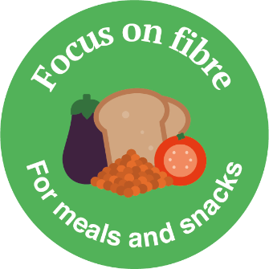
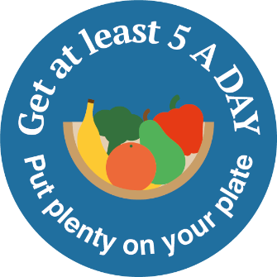
What can we do?
This year’s Healthy Eating Week has five themes to help everyone eat well for themselves and the planet!

Slide 8
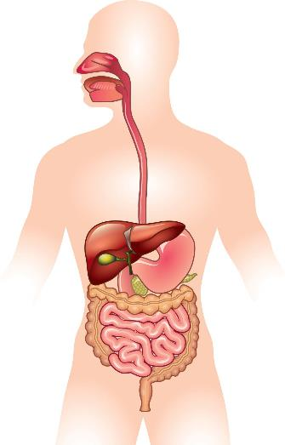
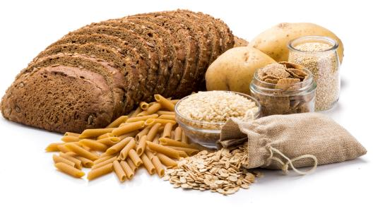
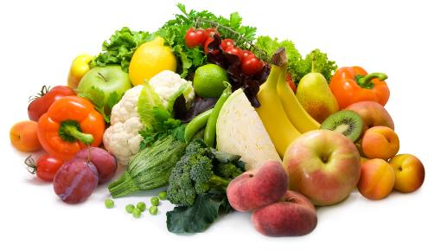
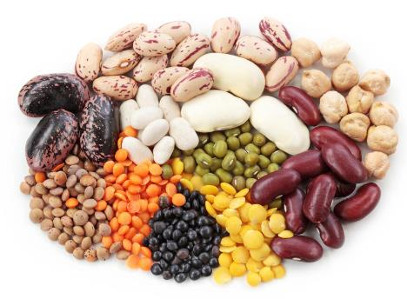
Focus on fibre – for meals and snacks
Why do we need fibre?
Where does fibre come from?
Wholegrain foods
Fruit and vegetables
To keep our digestive system healthy.
Beans, peas and lentils

Slide 9
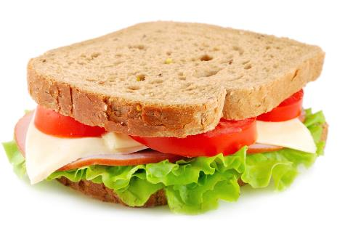
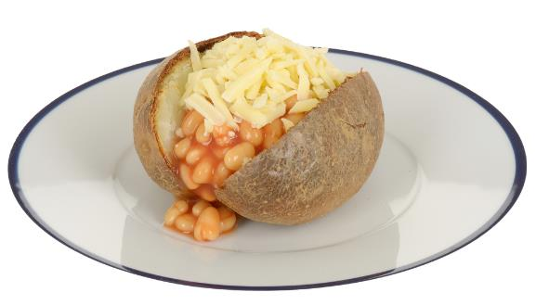
Find the fibre!
Where is the fibre in these dishes?
Foods that provide fibre
Wholemeal bread
Wholegrain foods
Tomato and lettuce
Potato with skin on
Fruit and vegetables
Beans
Beans, peas and lentils

Slide 10
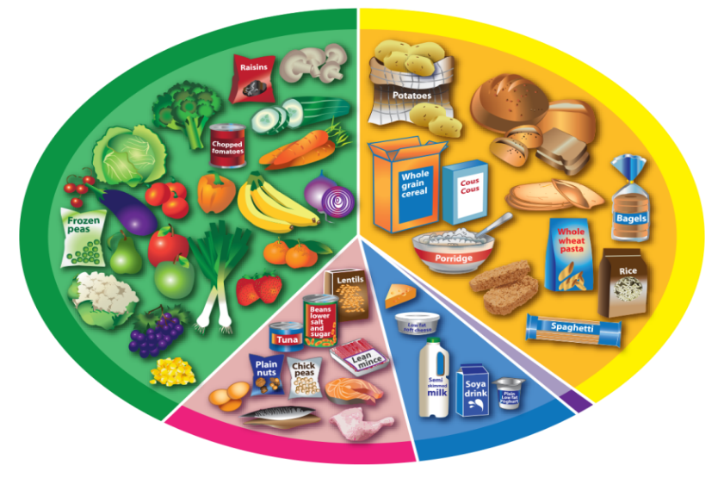
The Eatwell Guide
Foods that provide fibre
Where are the foods that provide fibre on the Eatwell Guide?
Wholegrain foods
Fruit and vegetables
The Eatwell Guide shows us that most of what we eat should come from plants.
Beans, peas and lentils

Slide 11
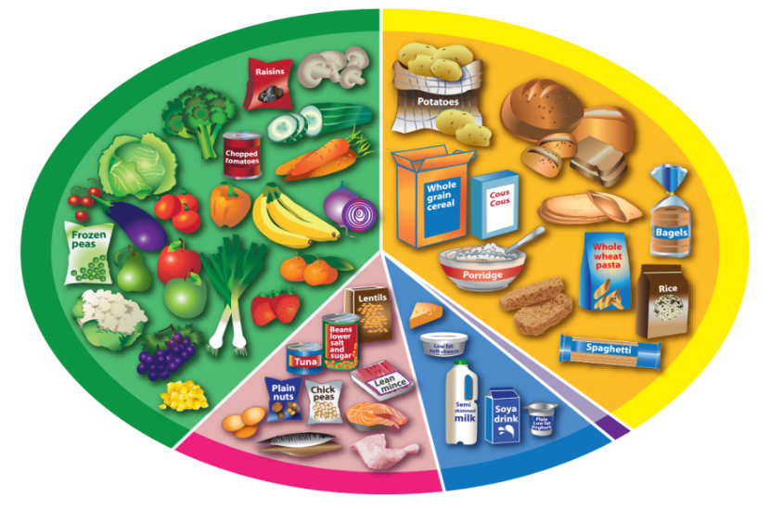
The Eatwell Guide
If we all followed the Eatwell Guide, this would help our health and the health of the planet!
30% lower greenhouse gases
4% lower water use
Reduce the number of new cases of type 2 diabetes, heart disease, and stroke in the UK population

Slide 12
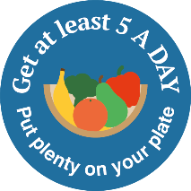
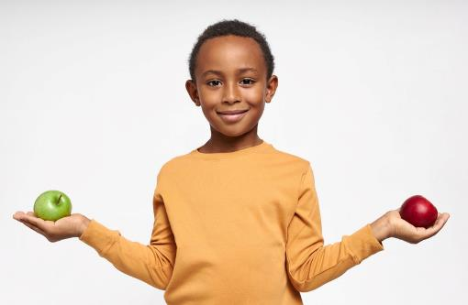
Get at least 5 A DAY – put plenty on your plate
Why do we need fruit and vegetables?
How much do we need?
At least 5 portions a day!
How much is a portion?
About what fits into the palm of the hand.
fibre!
For vitamins, minerals and....

Slide 13
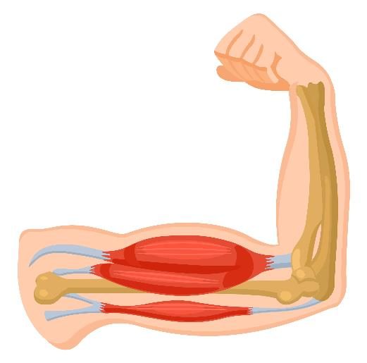
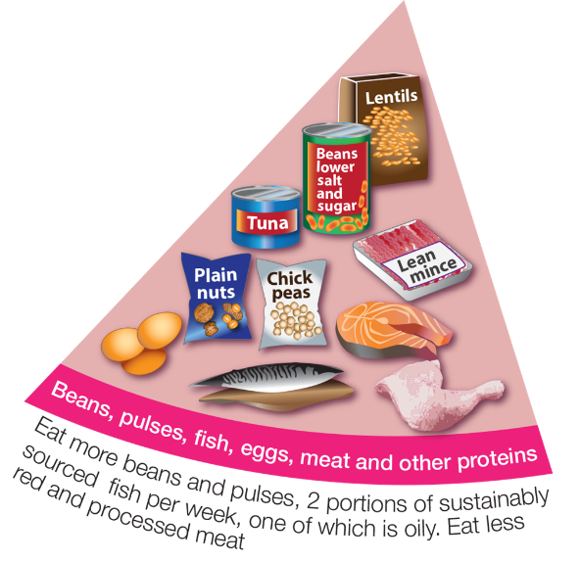
Vary your protein – be more creative
Why do we need protein foods?
What foods provide protein?
To help muscles and bones grow.
What foods can you see here?

Slide 14
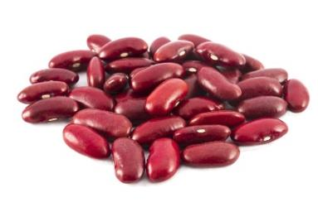
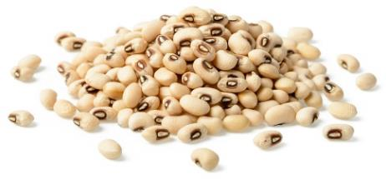
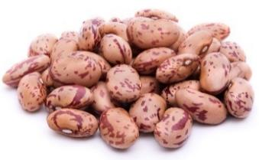
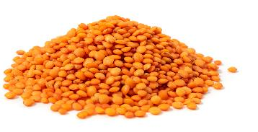
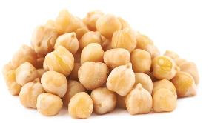
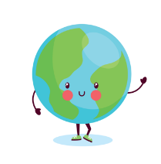
Vary your protein – be more creative
We should vary our protein and have protein foods from plants more often.
Can you name these protein foods from plants?
Red kidney beans
Black eyed beans
Pinto beans
Did you know that growing pulses (beans, peas and lentils) can improve soil health?
Red lentils
Chickpeas
How many of these have you tried?

Slide 15
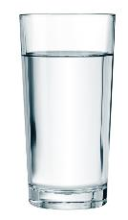
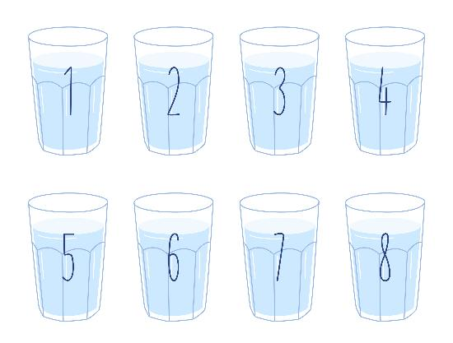
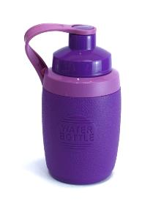
Stay hydrated – fill up from the tap
How much do we need to drink each day?
What are healthier drink choices?
Use reusable drink containers, like...
About 6-8 drinks a day.
or recyclable drink containers!

Slide 16
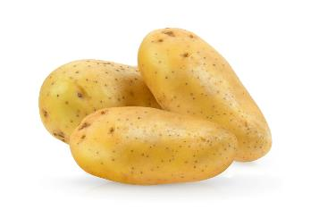
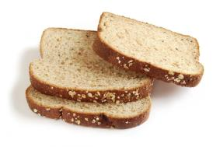
Reduce food waste – know your portions
What three foods do you think are most commonly wasted?
Why is it be important to reduce food waste?
Water
Land
Energy
To save the planet’s resources!
Potatoes, bread and milk.
To save money.

Slide 17
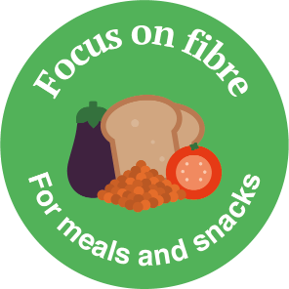
Remember!
Different foods have different impacts on our planet. This can make it confusing to know what foods we should choose, but there are things that we can all do to help, so…
Eat well for you and the planet!
Have a great Healthy Eating Week!

